Slide 1

State Advisory Board Meeting
January 12, 2021

Slide 2

Welcome and Introductions
Happy New Year!

Slide 3
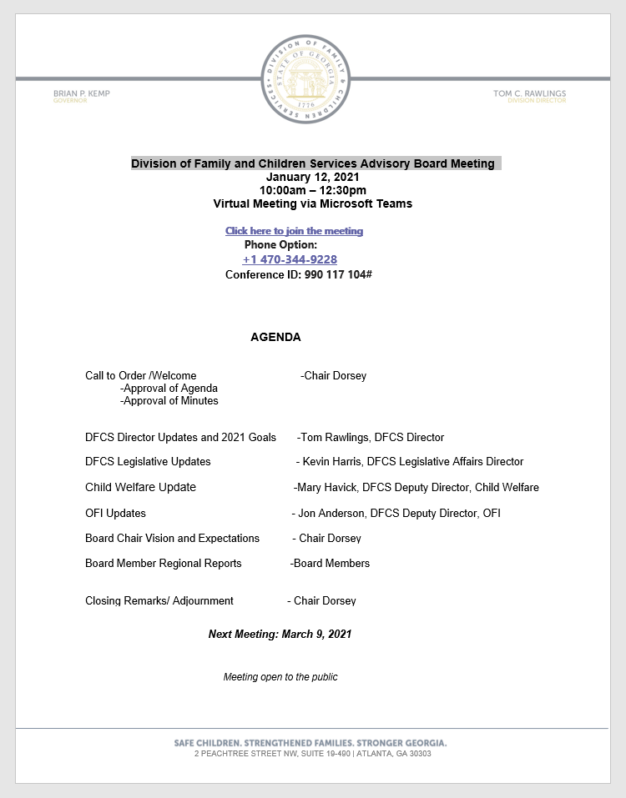
Approval of January 12, 2021 agenda

Slide 4
Approval of November 10, 2020 meeting minutes

Slide 5

Tom Rawlings
DIVISION DIRECTOR

Slide 6
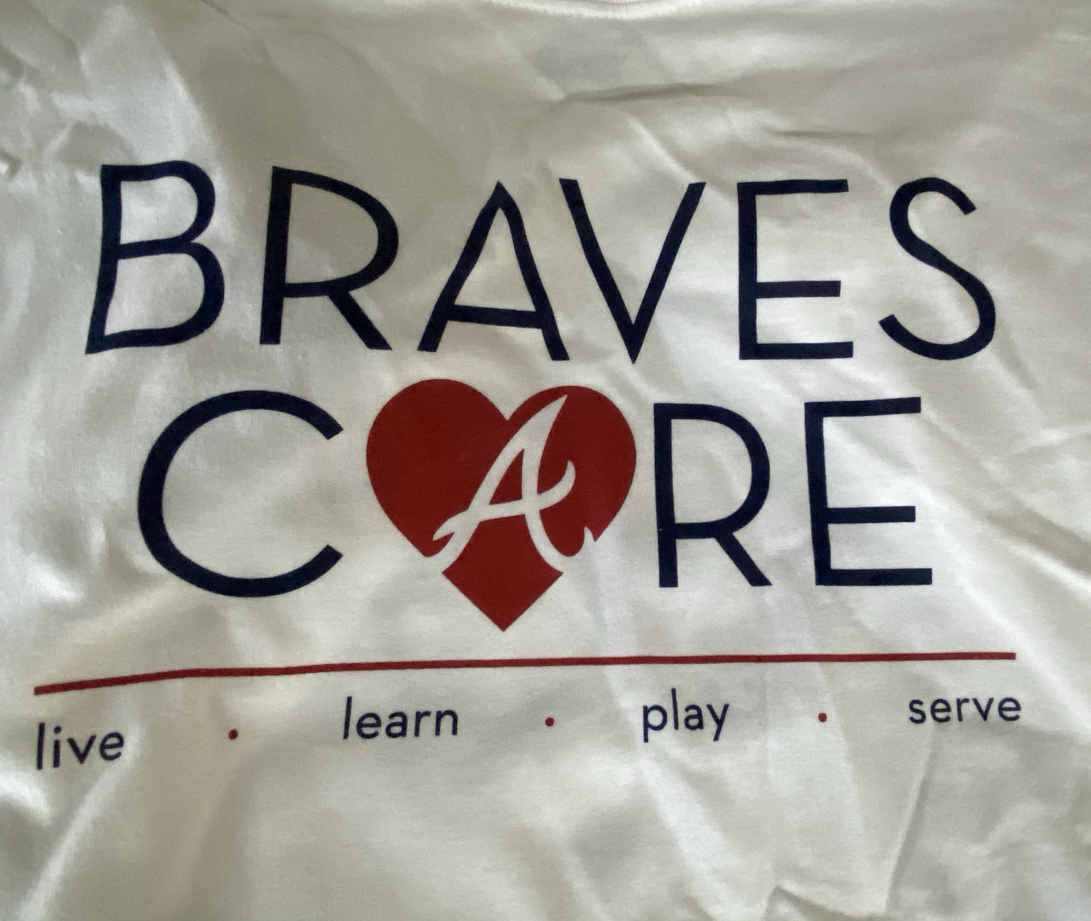
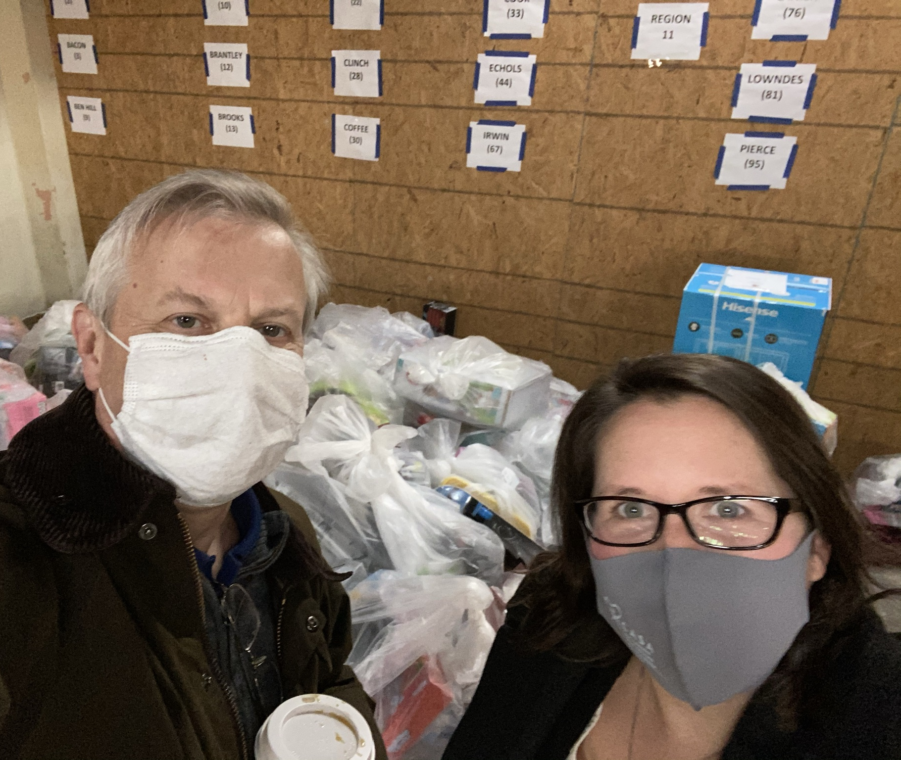


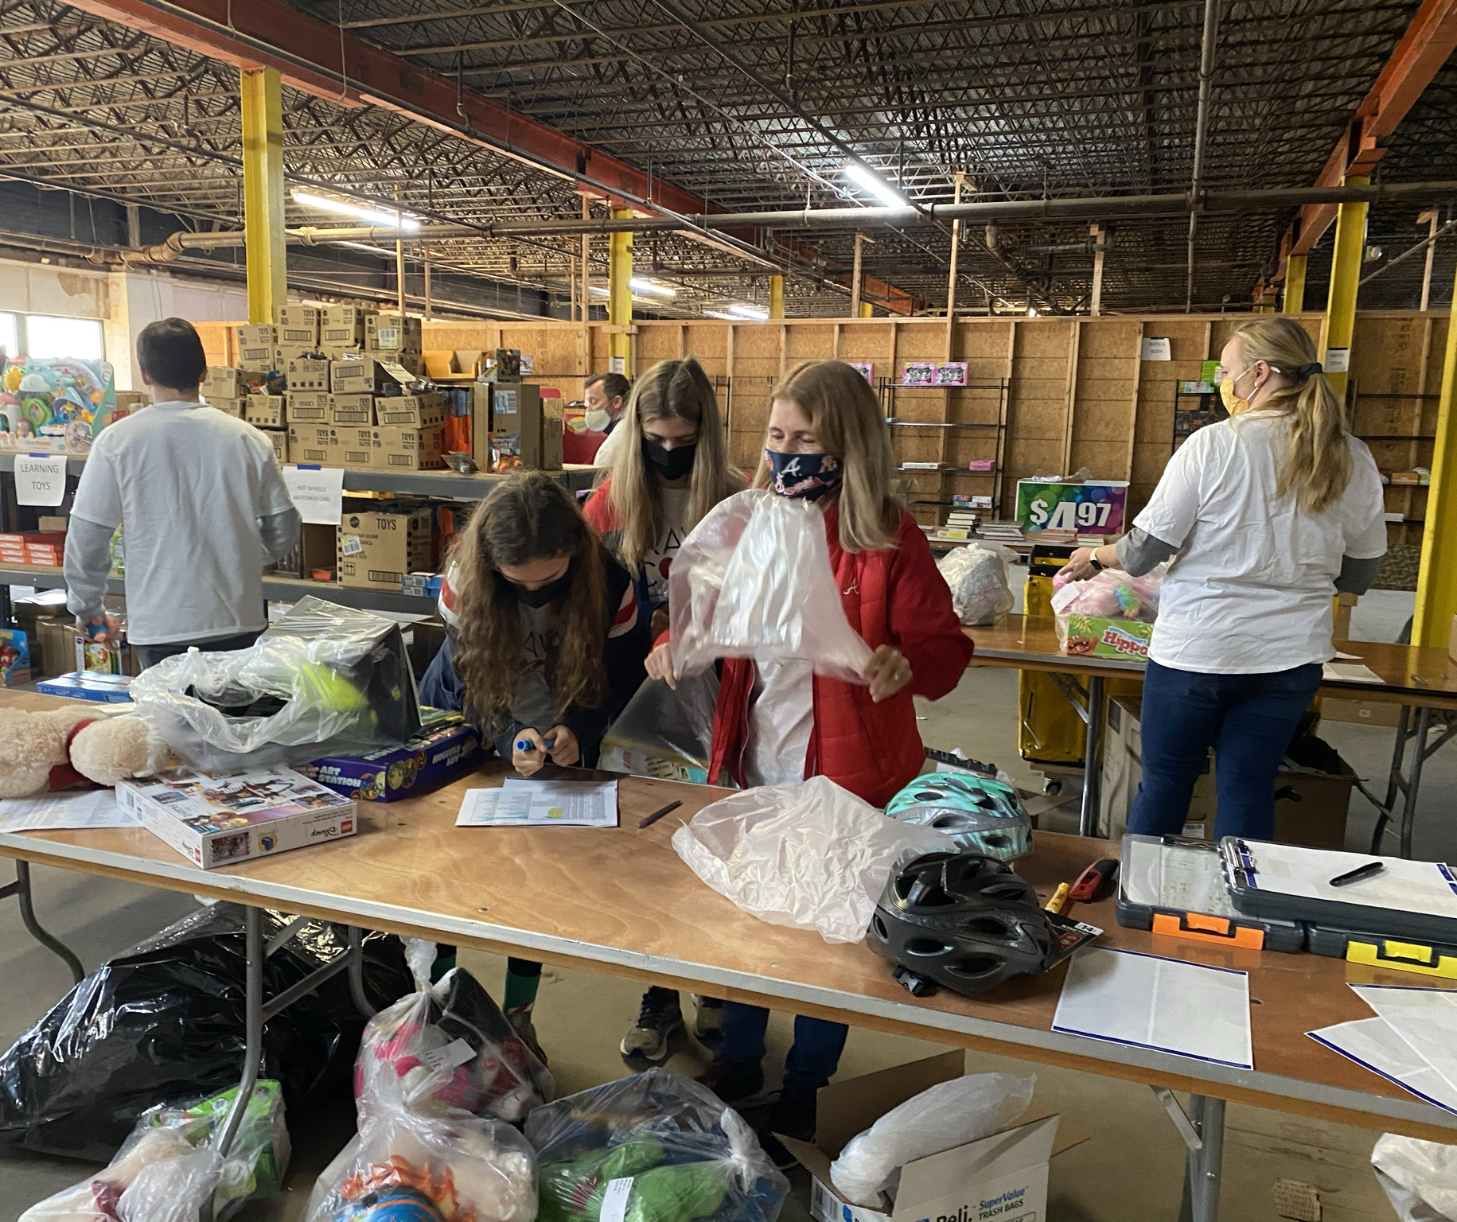
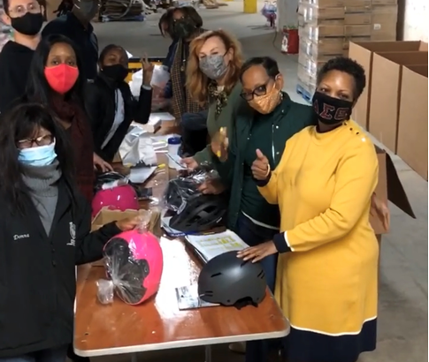

Slide 7


Slide 8


Slide 9

Questions
Tom C. Rawlings
Director, DFCS
Tom.Rawlings@dhs.ga.gov
Office | 404.463.9234

Slide 10

DFCS Legislative Updates
Kevin Harris
Legislative Affairs Director

Slide 11
2021-2022 Legislative Session
Biennial Session
No more than 40 “working days”
Legislative Process
  State of the Union
  MLK Jr. Week
  Crossover Day
  Sine Die
Key Players
  Governor Brian Kemp
    Floor Leaders
  Lt. Gov Geoff Duncan
    Speaker Pro Temp and Committee Chairs
  Speaker David Ralston
    Leadership Team and Committee Chairs
Committees of significance to DFCS this session
Appropriations (House and Senate)
Juvenile Justice (House)
Judiciary Non-Civil (House) and Judiciary (Senate)
Health and Human Services (House and Senate)
Education (House) & Education and Youth (Senate)

Slide 12

Proposed Legislation 2021

Slide 13
Description: Adoption Code Reform and Increased Tax Credit for Adoptions
  Rule/Law: Title 19 and Title 48
  Recommendation: During the 2020 legislative session, the Administration proposed House Bill 913 which was sponsored by Representative Bert Reeves. This important piece of legislation did not pass during the last session but should be recommitted to the General Assembly for further consideration. In addition, House Bill 934 was proposed during the 2020 legislative session that would have increased the adoption tax credit from $2000 to $6000. This piece of legislation was supported by Governor Kemp and should be recommitted for consideration.
  Potential Impact: The impact of this legislation would be three-fold: First, this legislation would update Georgia’s adoption laws. Second, if the Governor wishes to include the tax credit, this aims to further incentivize families to adopt children from Georgia’s child welfare system. Third, the Division proposes including an addition that would provide additional guidance regarding child custody in circumstances where the child is not adopted in the allotted statutory timeframe.
  Need For Change: If this proposal is not endorsed it would leave in place an adoption code that is out-of-date and not tailored to the most up-to-date statutes utilized by other states. Secondly, without the inclusion of the adoption tax credit, it might present continued challenges for the Division to solicit adoptive families to achieve permanency for children in foster care. Lastly, without the proposed change, there continues to be a gap in state statute that fails to identify who has legal custodial responsibilities over a child in the event an adoption is not finalized in the prescribed timeframe.

Slide 14
Description: Tuition Waivers – O.C.G.A. § 20-3-66
  Rule/Law: O.C.G.A. § 20-3-66
  Recommendation: First, it is recommended that all children who were previously placed in the state’s foster care system for at least 12 months be considered for in-state tuition by the University System of Georgia and the Technical College System of Georgia. Second, if the youth is qualified and receives DFCS Independent Living Services the amount of in-state tuition costs shall not exceed the available federal reimbursement amount.
  Potential Impact: This proposal has the ability to strengthen all youth who have been in the state’s child welfare system for twelve or more months. Education provided by a university, college, or technical school, is a primary avenue to ensure the success of our children who have previously experienced some form of abuse or neglect.
  Need For Change: At this time there is a funding gap between the amount of higher education and the available funds to support our young adults who continue to receive Independent Living Services from the Division. This proposal will close the funding gap that currently exists. Secondly, the guarantee will help incentivize young adults who either are, or have previously been, in the state’s foster care system to continue to pursue a form of secondary education. This incentivization will further strengthen Georgia through the young adult’s contributions to the state after finishing their post-secondary education.

Slide 15
Description: This proposal would add DFCS case managers to the list of individuals where it is required for either a judge of a superior, state, or probate court to issue an arrest warrant. Presently magistrate judges are also able to issue arrest warrants for DFCS case managers. There is a heightened standard used by superior, state, and probate courts that would aid in the protection of DFCS case managers.
    This proposal mirrors House Bill 555 from the 2020 Legislative Session. HB 555 did not have any opposition during the prior session, but, unfortunately, the legislation never made is to the Senate floor for a final vote.
  Rule/Law: O.C.G.A. § 17-4-40
  Recommendation: Include the addition of “DFCS case managers” in O.C.G.A. § 17-4-40.
  Potential Impact: Increases the protections afforded to DFCS case managers to prevent any potential retaliation by caregivers involved in a child protective services investigation.
  Need For Change: There have been instances throughout the State where a caregiver involved in a DFCS child protective services investigation files an arrest warrant through a magistrate court proceeding against an individual DFCS case manager. The standards used during these proceedings are different and since it is a criminal action, the Division is unable to assist the case manager with a defense. This proposal would increase the standards required for an arrest warrant to be made against a case manager and align those standards with what is already in place for peace officers, law enforcement officers, teachers, and other school administrators.

Slide 16
Description: Amend the identified statute to allow for the filing of a probate court guardianship petition prior to the child turning 18 years of age.
  Rule/Law: O.C.G.A. § 29-4-10
  Recommendation: The proposal would allow for the filing of a probate court guardianship for one year prior to the child turning 18 years of age.
  Potential Impact: This would aid the Division to improve the transition planning for those children that suffer from a life-long developmental disability or mental health condition that would deem them from being incompetent once they reach the age of adulthood.
  Need For Change: At this time, appropriately planning for the transition of children who suffer from a developmental disability or mental health condition poses significant challenges for the state’s child welfare system and those other systems who support incompetent adults. With this proposed change, it will allow for the Division to begin transition planning earlier during the child’s seventeenth birthday allowing for an intentional transition from foster care services to adult services aimed at meeting the individual’s needs.

Slide 17
Description: DFCS Clean-up Bill: Update various definitions related to child abuse and neglect in O.C.G.A. § 19-7-5; Update O.C.G.A. § 15-11-133.1 involving Temporary Alternatives to Foster Care; Juvenile Court Hearsay Exceptions, Extended Youth Services for Minors Transitioning to Adulthood, Improving Notice Requirements for Diligent Searches
  Rule/Law: Title 15 and Title 19
  Recommendation: The proposed recommendation includes:
  First: Amend various definitions included in O.C.G.A. § 19-7-5 which will align with the definitions contained in Title 15.
  Second: Amend O.C.G.A. § 15-11-133.1 which will further enhance the Temporary Alternative to Foster Care statute that was passed by the Georgia General Assembly in 2019.
  Third: Amend O.C.G.A. §§ 15-11-145, 15-11-215, 15-11-216, 15-11-230, 15-11-233 to authorize the juvenile court to accept all reliable and necessary evidence as dispositional hearings.
  Fourth: Delete O.C.G.A. § 15-11-340(e) that prevents a child from being able to sign a voluntary placement agreement within 12 months of their 21st birthday.
  Fifth: Amends O.C.G.A. § 15-11-211(c) to allow for additional notice to be provided to fictive kin in additional to all others currently listed in the statute.
Potential Impact: Each of the above-proposed revisions will strengthen Georgia’s child welfare system by: First aligning various statutes within Georgia’s code; second, ensuring the Division is able to prevent children from entering the foster care system whenever appropriate; third, allowing all appropriate evidence to be presented to a juvenile court for consideration; fourth, allowing children to receive all available services from the Division up until their 21st birthday and; fifth, increases the number of individuals who will receive notice once a child enters foster care in an to attempt to place them with an individual who already has a preexisting relationship with the child.
Need For Change: The above-recommended proposals have been gathered from practitioners throughout the state, juvenile court stakeholders, juvenile court judges, and policy experts to strengthen the work of the Division and of Georgia’s child welfare system.

Slide 18
Questions
Kevin Harris, DFCS Director of Legislative Affairs
Kevin.harris@dhs.ga.gov
404.293.8647
Notes:
It changes the minimum age of adoption from 25 to 21.

Slide 19

Child Welfare
Updates

Slide 20

2020 in Review
Virtual Everything: Contacts
Innovation: CICC Improvements, PAUSE
Simplification
Prevention, Safety, Permanency & Well-being
Family First: Act and Opportunity
Comprehensive Practice Model

Slide 21
Comprehensive Practice Model
A consistent basis for decision-making;
Clear expectations and values for working with families, children, youth, and with other stakeholders; and
A shared focus on outcomes.

Slide 22

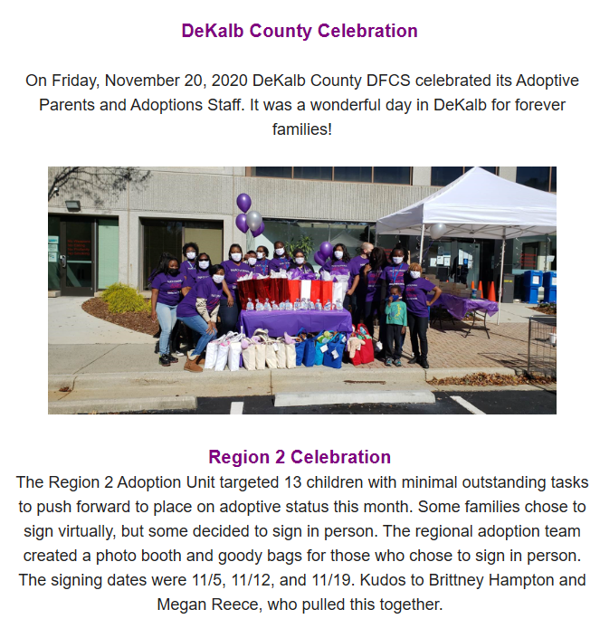
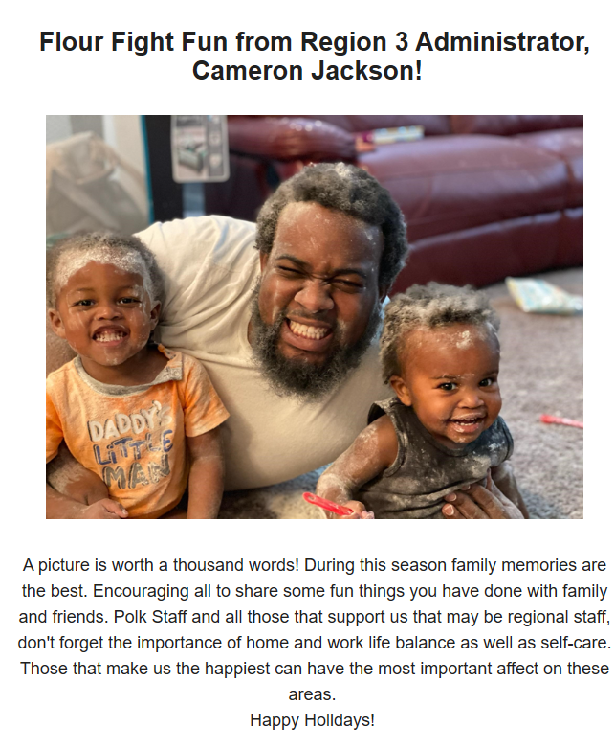
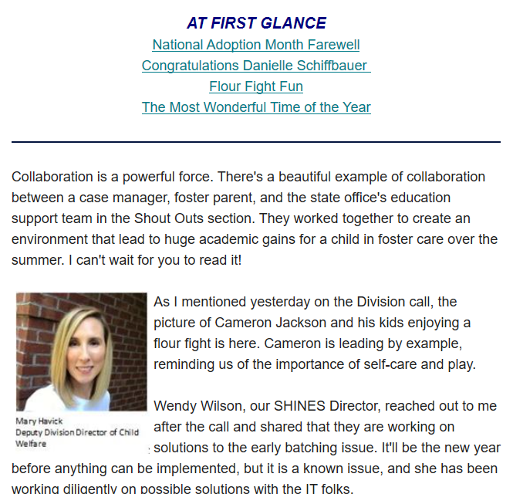

Slide 23

Staff Highlight
Natalie Towns
Prevention Section Manager
Chair, National Family Support Network Steering Committee
Parent Advisory Council
State Child Abuse Prevention Plan developed
Essentials for Childhood

Slide 24
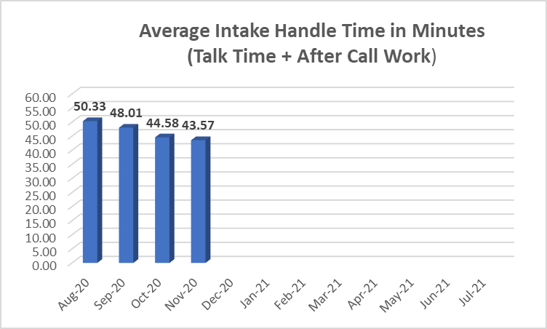

Comparison
Florida has an established 34 to 37 (minute) average handle time target. Texas previously had a target of 45 minutes but reduced it to 35 minutes, with current performance reported to be in the “high 30s.” CICC recently established an initial AHT target of < 40 minutes.

Slide 25
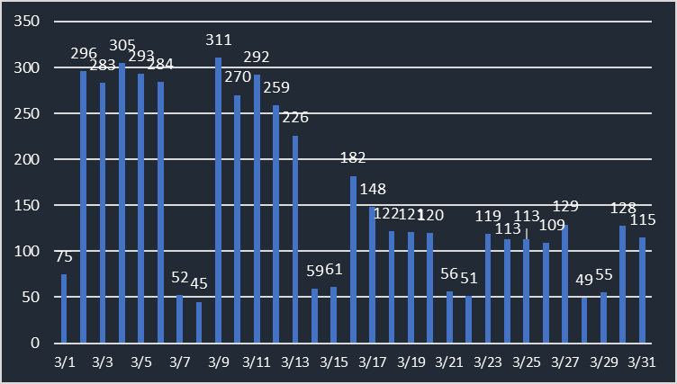
Assigned Intakes – March 2020

Slide 26
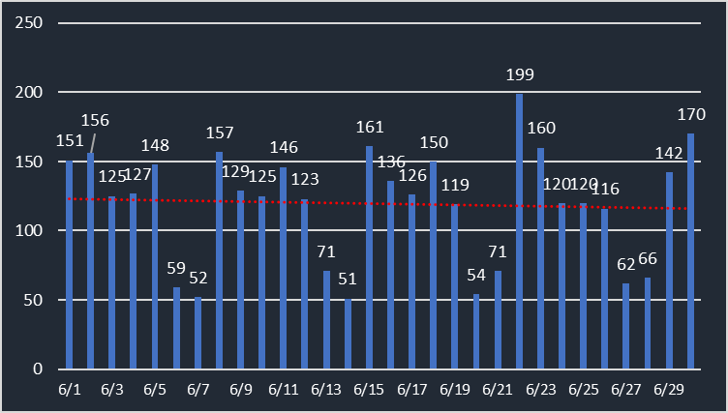
Assigned Intakes – June 2020

Slide 27
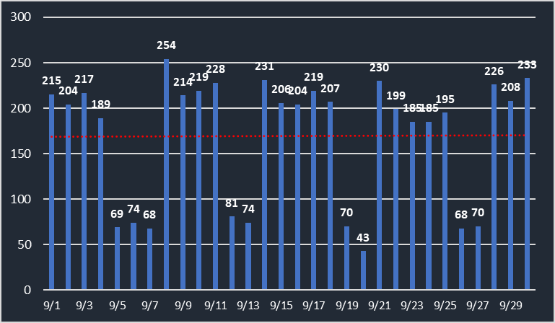
Assigned Intakes – September 2020

Slide 28
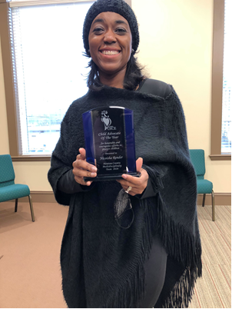
Staff Highlight
Nicoisha Render
Social Services Supervisor, Newton County
Child Advocate of the Year award by the Newton County Multi-Displinary Team
Nicoisha goes above and beyond to fight for what these children deserve and what is best for them. She is always willing to assist other agencies and partners working towards the same mission.

Slide 29
Virtual Contacts
Our final ECEM outcome for FFY2020 is nearly 97%
This exceeds the federal requirement of 95%
Georgia also easily exceeded the 50% in home requirement

Slide 30
Children / Youth in Foster Care

Slide 31

Simplification
Non-Resident Children Policy
CICC Emergency Contact Lines
CICC Emergency SHINES History Screens
Permanency Case Staffings
Dynamic Case Review Process
CDNFSI Reports Discontinued on Screen-outs
Calling the Reporter

Slide 32
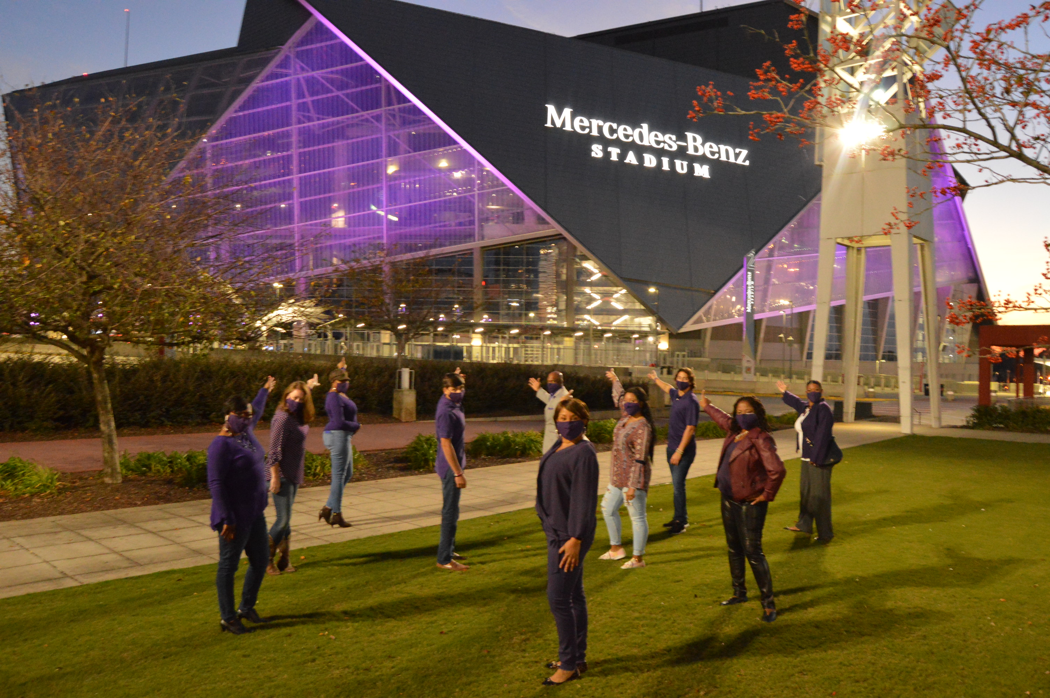
2020 National Observances
April: Child Abuse Prevention Month
May: Foster Care Month
June: Reunification Month
September: Kinship Care Month
November: Adoption Month

Slide 33

Family First: Act
Georgia’s Blueprint for Families First Newsletter
Advisory Council
Chapin Hall technical assistance
Webinar
Implementation team members

Slide 34

Family First: Opportunity
Champions of Blueprint for Family First
Family Support Redesign pilot

Slide 35
Family Support Redesign: Design Question
How might we design a system to support families with a robust community-based response that engages and empowers families without deeper system involvement?

Slide 36
Proposal Components
Structured process for “hot” hand offs from DFCS to community organization
Services and/or supports that are adapted based on family needs
Feedback loops and data sharing using a common set of data elements
Individual family outcomes not reported back to DFCS
Under development – supports for unmet civil legal needs

Slide 37
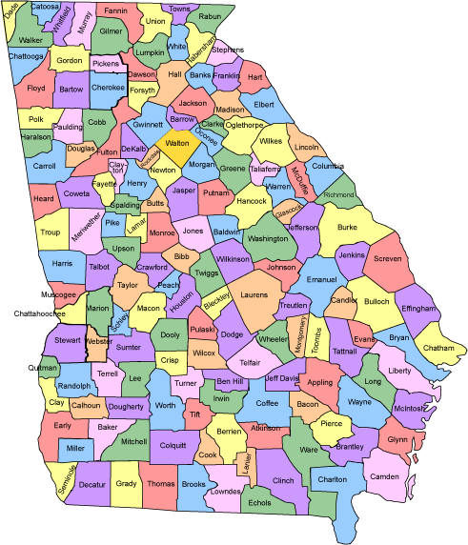



Pilot/Prototype
Georgia has identified organizations in three pilot counties to serve families:
  Union County Family Connection
  Foster Care Alliance/Mother’s Advocacy Project
  Columbus Community Action Agency
  Each site is part of our State of Hope Ecosystem

Slide 38
2021 – Looking Ahead
Simplification
“Flag and Follow” Pilot
Continued Kenny A Progress
Comprehensive Practice Model – Field-testing
Safety, Well-being & Permanency Outcomes
Collaboration
Supportive Community

Slide 39
QUESTIONS
Mary Havick, Deputy Division Director of Child Welfare
Mary.Havick@dhs.ga.gov

Slide 40
OFI
Updates

Slide 41


COVID-19
UPDATE

Slide 42

Contents
Program Update – People, Processes & Technology
SFY Historical Issuance Trends
SNAP Applications Received by Date Submission Mode
Agency Response
Applications Received/ Approved/ Denied
SNAP Persons and Households
SNAP Timeliness
SNAP Issuances (Dollars) – March 2020 – November 2020
November 2019 – November 2020 (Combined SNAP Issuances)
December 2020 Issuance Projections
PEBT Final Numbers

Slide 43

OFFICE OF FAMILY INDEPENDENCE

Slide 44


Slide 45


New releases
System upgrades
DDS interface
$tars interface
Work Number interface
Go-Green Opt-In
Staff training

Slide 46


Slide 47

DATA TRENDS

Slide 48
SFY Historical Issuance Trends

Slide 49
SNAP Applications Received by Date and Submission Mode

Slide 50

COVID-19
Agency Response
March 2020
April 2020
May 2020
June 2020
July 2020
P-SNAP
Renewals extension
ABAWD requirements suspension
P-SNAP
Renewals extension
ABAWD requirements suspension
P-SNAP
Renewals extension
ABAWD requirements suspension
Online EBT use with instore pickup
P-SNAP
Renewals extension
ABAWD requirements suspension
Online EBT use with instore pickup
Online EBT use for grocery delivery
P-SNAP
Renewals extension
ABAWD requirements suspension
Online EBT use with instore pickup
Online EBT use for grocery delivery
LIHEAP CARES
CARES Act Medicaid and CHIP Provider Relief Fund Distribution
P-EBT

Slide 51
Statewide | Jan-2020 | Feb-2020 | Mar-2020 | Apr-2020 | May-2020 | Jun-2020 | Jul-2020 | Aug-2020 | Sep-2020 | Oct-2020 | Nov-2020
# Apps Received | 39,459 | 45,477 | 94,258 | 151,896 | 67,308 | 56,186 | 59,495 | 53,584 | 45,898 | 52,114 | 53,616
# Apps Approved | 26,681 | 28,242 | 41,832 | 140,852 | 49,792 | 34,936 | 27,986 | 29,601 | 26,478 | 27,638 | 29,171
# Apps Denied | 9,177 | 11,831 | 19,377 | 50,480 | 25,940 | 19,874 | 24,414 | 22,337 | 19,978 | 17,631 | 19,028

Slide 52
Statewide SNAP Persons and Households
Month | Persons | Households
19-Oct | 1,370,779 | 637,219
19-Nov | 1,369,503 | 637,644
19-Dec | 1,348,944 | 629,517
20-Jan | 1,399,709 | 625,814
20-Feb | 1,342,624 | 626,808
20-Mar | 1,408,652 | 656,081
20-Apr | 1,631,090 | 781,055
20-May | 1,712,499 | 825,057
20-Jun | 1,762,739 | 852,661
20-Jul | 1,806,766 | 876,044
20-Aug | 1,839,348 | 893,828
20-Sep | 1,874,541 | 911,938
20-Oct | 1,753,290 | 853,522
20-Nov | 1,578,041 | 767,298
Source: FNS 388
Note: October and November data is not final. Our official FNS 388 reports are not available until 2 months after the close of each month.

Slide 53
Statewide | Jan-20 | Feb-20 | Mar-20 | Apr-20 | May-20 | Jun-20 | Jul-20 | Aug-20 | Sep-20 | Oct-20 | Nov-20
SNAP | 88.09% | 88.74% | 87.80% | 84.14% | 97.11% | 98.75% | 96.73% | 96.81% | 95.91% | 95.45% | 93.76%
TANF | 94.28% | 96.71% | 98.15% | 93.14% | 92.97% | 99.35% | 99.82% | 99.82% | 99.85% | 99.80% | 99.54%
MA | 71.77% | 69.83% | 67.66% | 74.26% | 54.71% | 91.34% | 94.99% | 96.48% | 96.43% | 96.58% | 96.88%

Slide 54
March 2020 – November 2020 Issuances
STATEWIDE
P-SNAP issuances began in March 2020. P-EBT Issuances began in July 2020 and ended in September with final issuance of $89,770,640.
May – November 2020 P-SNAP issuances include monthly P-SNAP and weekly P-SNAP sweeps.
Regular Issuances include both on-going and daily issuances.

Slide 55
Total amounts include regular SNAP on-going/daily issuances and P-SNAP issuances. P-SNAP is the COVID-19 emergency allotment. P-EBT is the allotment for children eligible for the free/reduced school lunch program.
March 2020 includes regular SNAP and monthly P-SNAP ($63,750,742). April 2020 includes regular SNAP and monthly P-SNAP ($71,688,274).
May 2020 includes regular SNAP, monthly P-SNAP ($77,976,133) and P-SNAP sweeps for prior months totaling $30,688,486. June 2020 includes regular SNAP and monthly P-SNAP including sweeps totaling $80,701,289).
July 2020 includes regular SNAP, monthly P-SNAP including sweeps totaling $83,347,423 and P-EBT totaling $155,854,018 (including mass issuance for SNAP families)
August 2020 includes regular SNAP, monthly P-SNAP including sweeps totaling $84,933,741 and P-EBT totaling $33,937,002.
September 2020 includes regular SNAP, monthly P-SNAP including sweeps totaling $87,998,951 and P-EBT totaling $100,385,379 (including final issuance for remaining P-EBT families on 9/30/2020
October 2020 includes regular SNAP and monthly P-SNAP including sweeps totaling $85,530,137. November 2020 includes regular SNAP and monthly P-SNAP including sweeps totaling $91,174,928.

Slide 56
December 2020 Projected Issuances
December 2020 projections for Regular SNAP and P-SNAP are based on average of issuances for September - November 2020 issuances.
The increase in regular SNAP issuances is in line with its highest peak in SFY 2013 ($249M) during the previous recession.

Slide 57
Pandemic Electronic Benefit Transfer (P-EBT)
Students
Month Issued | SNAP Clients | Non-SNAP Clients | FRL Direct | Total
July | 491,904 | 126,762 |  | 618,666
Aug | 5,915 | 118,551 | 1,006 | 125,472
Sept | 2,501 | 32,172 | 353,083 | 387,756
Total | 500,320 | 277,485 | 354,089 | 1,131,894
Issued amounts
Month Issued | SNAP clients | Non-SNAP Clients | FRL Direct | Total
July | $ 126,173,376 | $ 32,514,710 |  | $ 158,688,086
Aug | $ 1,517,198 | $ 30,408,332 | $ 450,414 | $ 32,375,943
Sept | $ 641,507 | $ 8,252,118 | $ 90,578,102 | $ 99,471,726
Total | $ 128,332,080 | $ 71,175,159 | $ 91,028,516 | $ 290,535,755

Slide 58


Slide 59


Thank You
Georgia Division of Family
& Children Services
2 Peachtree Street, Suite 19-454
Atlanta, GA 30303

Slide 60

Board Chair Vision & Expectations

Slide 61
Board Member Regional Reports
Please briefly address the following:
-

Slide 62
Closing Remarks and Adjournment
Next board meeting: March 9, 2021

