Slide 1

State Advisory Board Meeting
July 13, 2021

Slide 2

Welcome and Introductions

Slide 3
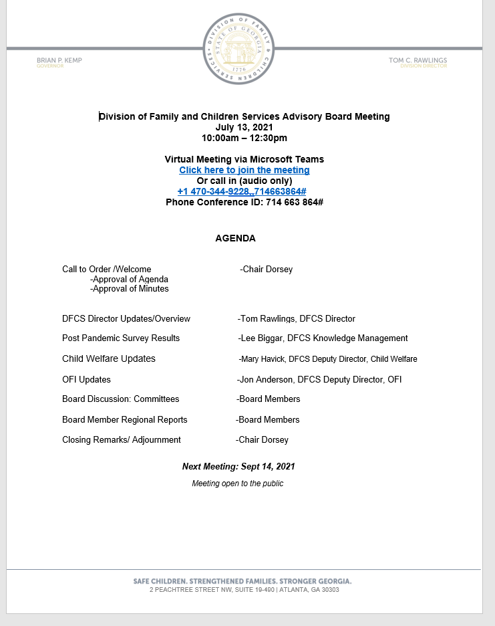
Approval of July 13, 2021 agenda

Slide 4
Approval of May 9, 2021 meeting minutes

Slide 5

Division Overview
Tom C. Rawlings
Director

Slide 6


Slide 7


Slide 8

Amped Kids First Talent Show
September 18, 2021 | Gainesville, GA
Auditions open until July 30th
Open to Foster Youth only [ages 7-21]
Prizes include a trip to Nashville, TN, music instruments, recording studio time, and more!

Slide 9
House Bill 548- Department
  Chairman Katie Dempsey
    Authorizes DFCS and the Administrative Office of the Courts to work together to develop policies and procedures for purposes of data sharing ensuring compliance with Federal HIPAA law
  We have met with Administrative Office of the Courts on how to proceed
  Effective Date July 1, 2021
House Bill 562-Department
  Rep. Kasey Carpenter
    Adds DFCS case managers to the list of government officials that require notice of warrants for arrest for offenses alleged to have been committed while in the performance of his or her duty.
  Effective Date July 1, 2021
Senate Bill 107-Administration
  Chairman Brian Strickland
    Tuition waiver bill
    Provides a waiver of tuition and all fees, for qualifying foster and adopted students by units of the Technical College System of Georgia
    Recommends the Board of Regents adopt a similar policy for units of the University System of Georgia
  Carmen and her team have been diligently working on this with TCSG and now Board of Regents
    Due to complexities of post-secondary education, this will be more challenging than first believed
  Effective on July 1, 2021

Slide 10
  House Bill 81-Administration
  In addition to funds already discussed in the Governor’s original proposed budget, the Conference Committee last night added:
  Increase funds to establish a therapeutic foster care program and leverage federal funds.
      $6,700,000
  Increase funds to support community partnerships to stem learning loss due to COVID-19 for K-12 students.
      $4,727,964
  Restore funds for contracts for educational services with the Multi-Agency Alliance for Children
      $951,700
  Broken Shackles and CASA money from the Senate version was maintained as well
  July 1, 2021-June 30, 2022
House Bill 114-Administration
  Administrative Floor Leader Bert Reeves
    Revises the tax credit for the adoption of foster children from $2,000 to $6,000
  Effective on July 1, 2021, and shall be applicable to adoptions occurring in all taxable years beginning on or after January 1, 2021

Slide 11
House Bill 146-Other
  Sponsored by Rep. Houston Gaines
    Offers three weeks of paid parental leave after the birth, adoption or foster placement of a child to eligible state employees.
  Much of this will be reflect in the SAO software and you will be able to see when this change has taken place
  Effective Date July 1, 2021
House Bill 154-Administration
  Administrative Floor Leader Bert Reeves
    Current version is a 51-page bill that does a number of things to strengthen and clarify the code section to protect Georgia’s children.
    Addresses voluntary surrender, kinship, criminal record checks, forms and notification requirements.
    Lowers the age at which an individual may petition the court to adopt a child from age 25 to 21. This change is written with the intention of making it easier for close relatives to adopt children out of foster care.
    Senate Judiciary added language from Rep. Beth Camp’s House Bill 706 to insert the guardianship bill language
  Implementation Date: Effective Date July 1, 2021
House Bill 163-Other
  Chairman Sharon Cooper
    Directs DCH to submit state plan amendment to implement express lane enrollment in Medicaid
    Children already eligible for SNAP (food stamps) would likely be eligible for Medicaid or PeachCare for Kids as well. This legislation would eliminates requiring two applications to ensure that more children get the preventive and medical care they need.
    DCH is following their internal process (which in many times involves a public hearing) in order to submit the amendment
  Effective Date July 1, 2021

Slide 12
Senate Bill 20-Other
  Chairman Chuck Payne
    Adds three (3) positions to the Child Advocate Advisory Committee:
      One current or former foster parent appointed by the Governor;
      One former foster child who attained the age of majority or graduated from high school while still in the Georgia foster care system appointed by the Lieutenant Governor
      One individual who has served for at least three years as a court appointed special advocate (CASA) appointed by the Speaker of the House of Representatives
  New Director, Jerry Bruce, will be working to get nominations for the newly created positions approved and sworn in
  Effective Date July 1, 2021

Slide 13
Two bills passed during legislative session but not implemented this year:
House Bill 511-Administration
  Administrative Floor Leader Bert Reeves
    Enabling legislation for constitutional amendment passed on 2020 ballot
    Dedicates specific fees by general law for 10 years and creates the framework to segregate the collections for each fee dedicated in this manner as a unique trust fund earning interest within the Office of the Treasurer.
    Effective Fiscal Year 2023, the amount of the annual collections and interest, as reported to and confirmed by the three budget offices, provides the statutory basis for the amount to be appropriated in next budget cycle.
    Applies to the State Children's Trust Fund, under the purview of the director of the Division of Family and Children Services;
  Except as provided for in Section 23, this Act shall become effective on July 1, 2022
Senate Bill 28-Administration
  Administrative Floor Leader Bo Hatchett
    Updates various definitions involving temporary alternatives to foster care; juvenile court hearsay exceptions; extended youth Services for Minors transitioning to adulthood and improving notice requirements for diligent searches
    Input from juvenile court judges, juvenile court stakeholders, policy experts and practitioners across the state
  Becomes effective on January 1, 2022
    Provides more time to allow us to prepare for its implementation

Slide 14
Questions?
Contact me:
Tom.Rawlings@dhs.ga.gov

Slide 15

DFCS Post COVID Operations Decision Support Project
Overview of Findings
Presentation to the DFCS Advisory Board
July 13, 2021
Presented by Lee Biggar, Senior Director of Knowledge Management

Slide 16
Project Objectives
Understanding of how remote work has impacted agency workforce and customers
Inform agency decisions on remote work and improvements to customer service

Slide 17
National Child Welfare Workforce Institute Survey
Available to all DFCS staff
Anonymous online survey
Priority areas of focus
  Customer Service/Interaction/Engagement/Well-being
  Professional Support
  Supervision
1822 OFI responses (52% of which were frontline)
1666 CW responses (37% of which were frontline)

Slide 18
Key Findings
Percent of respondents who believe they are very successful engaging customers/children/families since March 2020
  OFI 91%
  CW 80%
Percent of respondents who believe they are somewhat or significantly better off when it comes to their mental health
  OFI 66%
  CW 60%
Percent of respondents who believe they are somewhat or significantly better off when it comes to their productivity
  OFI 80%
  CW 75%

Slide 19
Key Findings (cont.)
Percent of respondents who believe they are somewhat or significantly better off when it comes to their level of job-related stress
  OFI 67%
  CW 62%
Percent of respondents who believe they are somewhat or significantly better off when it comes to their ability to serve customers
  OFI 67%
  CW 58%
Percent of respondents who believe they are somewhat or significantly better off when it comes to their ability to manage workload
  OFI 75%
  CW 70%

Slide 20
Key Findings (cont.)
Most staff were able to maintain connection to peers (especially supervisors)
Peer connection was significantly associated with lower levels of job-related stress
Approximately 96% of respondents found their supervisor to be accessible and trust them with time management
90% were satisfied with the frequency of supervision they received

Slide 21
Key Findings (cont.)
Percent of respondents who believe communication is somewhat or significantly better
  OFI 56%
  CW 55%
Percent of respondents who were satisfied with access to computers, mobile technology, internet, technical support and software
  OFI and CW over 90%
Percent of respondents who were satisfied with access to office equipment
  OFI 76%
  CW 68%
Percent of respondents who believe effectiveness of training and professional development is somewhat or significantly better*
  OFI 46%
  CW 45%
  * Limited hiring prior to survey completion date

Slide 22
Survey Findings Summary
Despite the challenges faced by DFCS staff to change the way they work since March 2020, most have felt supported by their peers and supervisors, have had access to necessary technology and trainings, and have experienced improvements in well-being and work performance. Although staff overwhelmingly feel they have been very successful engaging others, they believe they could do their job most effectively with a little more time in the office and field (consistent with a hybrid model)

Slide 23
Carl Vinson Institute of Government Group Interviews
Conducted 26 group interviews
106 Participants
DFCS staff (all levels), stakeholders, providers and parents
Conducted virtually
Anonymity protected

Slide 24
Key Findings
Participants indicated a successful transition to remote work
Participants reported numerous benefits related to working remotely
  Reduced travel
  Time savings
  Less disruption
  Improved productivity
  Better communication (internally and with customers and partners)
  Less stress
  Increased autonomy
  Convenience
  Cost savings (gas, dry cleaning, eating at home)

Slide 25
Key Findings (cont.)
Participants reported several challenges related to working remotely
  Missing comradery of working in-person with peers
  Internet connectivity
  Lack of access to office equipment
  Work/life balance
  Training and onboarding of new staff
  Missing impact of human-to-human contact with customers
  Virtual meeting etiquette
  Managing customer expectations (reasonable access to staff)

Slide 26
Group Interview Findings Summary
Participants expect some level of remote work and virtual service delivery
Participants indicated that OFI had more of an ability to work remotely and process applications
Related to CW, participants indicated that in-person contact with children and families is critical for relationship building, safety assessment and effective case management, especially for high-risk populations
Virtual interaction may be good when relationships already exist, and caseworkers are working with known families

Slide 27
Next Step
Utilize project data to establish policies and processes that best promote workforce well-being, excellent customer service and collaborative partnerships with external partners and providers

Slide 28

Child Welfare
Updates

Slide 29
In-person Contacts
Gradual return to in-person contacts in existing cases with no immediate safety issue
  May, June & July – 33%
  August – 50%
  September – 100%
Beginning in September, all work will be done in-person
Virtual visits will still be encouraged for supplemental contact between case managers and families and between separated families and children
Workgroup to explore expanded use to virtual contacts in the future

Slide 30
Retention Efforts
Career ladder for case managers
  Social Services Specialist 1 – all new hires
  Social Services Specialist 2 – after 2 years of service, completed all training, good standing and 3.0 or better on last performance review
  Social Services Specialist 3 – after 5 years of service, 20 hours per year of professional development training, good standing and 3.0 or better on last performance review
MSW or associated behavioral science degree – 10% pay increase
LCSW – 10% pay supplement

Slide 31
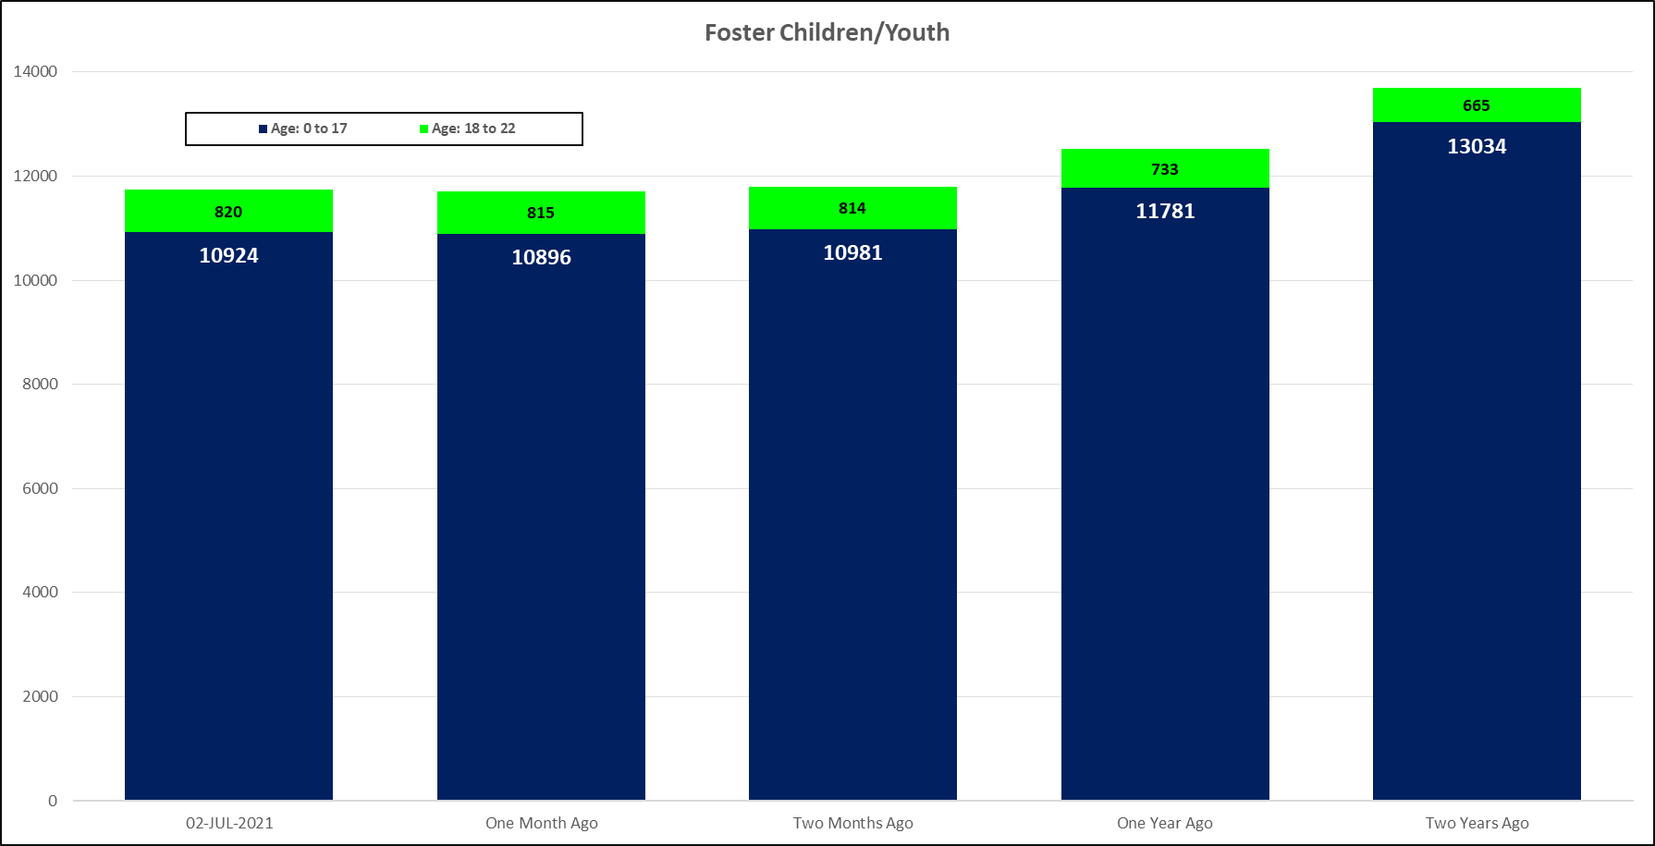

Slide 32
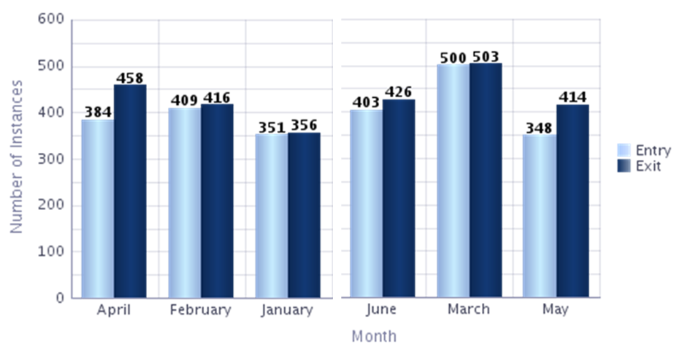
Foster Care Entries vs Exits from LENSES 7/7/2021

Slide 33
Adoptions

Slide 34
Caseload Averages by Program Area
Average Caseworker Caseload, June 2021
*Includes Caseworkers with at least 5 of the particular case type
Foster Care |  |  |  | Family Preservation |  |  |  | Investigations & Family Support
REGION_NUM | RAVG | RMED |  | REGION_NUM | RAVG | RMED |  | REGION_NUM | RAVG | RMED
1 | 25 | 28 |  | 1 | 10 | 10 |  | 1 | 17 | 16
2 | 25 | 26 |  | 2 | 14 | 13 |  | 2 | 23 | 22
3 | 26 | 28 |  | 3 | 20 | 21 |  | 3 | 25 | 23
4 | 16 | 15 |  | 4 | 10 | 10 |  | 4 | 15 | 14
5 | 26 | 23 |  | 5 | 11 | 9 |  | 5 | 16 | 13
6 | 22 | 23 |  | 6 | 11 | 9 |  | 6 | 16 | 15
7 | 24 | 22 |  | 7 | 9 | 10 |  | 7 | 16 | 14
8 | 26 | 27 |  | 8 | 11 | 10 |  | 8 | 15 | 9
9 | 21 | 20 |  | 9 | 10 | 11 |  | 9 | 14 | 13
10 | 20 | 21 |  | 10 | 12 | 12 |  | 10 | 15 | 14
11 | 34 | 36 |  | 11 | 16 | 14 |  | 11 | 18 | 17
12 | 26 | 25 |  | 12 | 12 | 11 |  | 12 | 20 | 20
13 | 24 | 24 |  | 13 | 17 | 18 |  | 13 | 31 | 31
14 | 14 | 12 |  | 14 | 8 | 7 |  | 14 | 21 | 18
State | 23 | 22 |  | State | 12 | 11 |  | State | 19 | 17

Slide 38

National Reunification Month 2021
#ALLIN

Slide 39
All In 2021!
This year’s Reunification Month theme was "All In-Reunification 2021". Reunification is not possible without a wide array of people (parents, kin, case managers, stakeholders, providers) who are committed to supporting and strengthening our families. When “all” are “in,” we are successful at reunifying families safely, timely, and successfully.

Slide 40

Reunification Values
Maintaining children with their own families and safe family reunification are the preferred permanency options for all children served by Georgia’s child protection.
For most children in foster care, reunification with their family is their best option for a permanent and loving home.
All children need the care, love, security, and stability of family unity—including parents, siblings, grandparents, and other extended family members—to provide a solid foundation for personal growth, development, and maturity.
Reunification takes work, commitment, and investment of time and resources by parents, family members, social workers, foster parents, service providers, attorneys, courts, and the community.

Slide 41

2021 Reunification Heroes
CM Tiowanna Horne (R10)
CM Brittanie Andazola (R4)
CM Malorie Williams (R10)
Parent Navigator Colleen Puckett
CM Ryan Ellis (R3)
CM Beth Battles (R3)
Administrator Samantha Moeller (R1)

Slide 42
2021 Reunification Heroes
Peer Advocate Christina Haynes
Parent Erin Thomas
CM Nancy Williams (R1)
Partnership parents Scott and Wendy Titus
CM Carmanelia Bryant (R12)

Slide 43
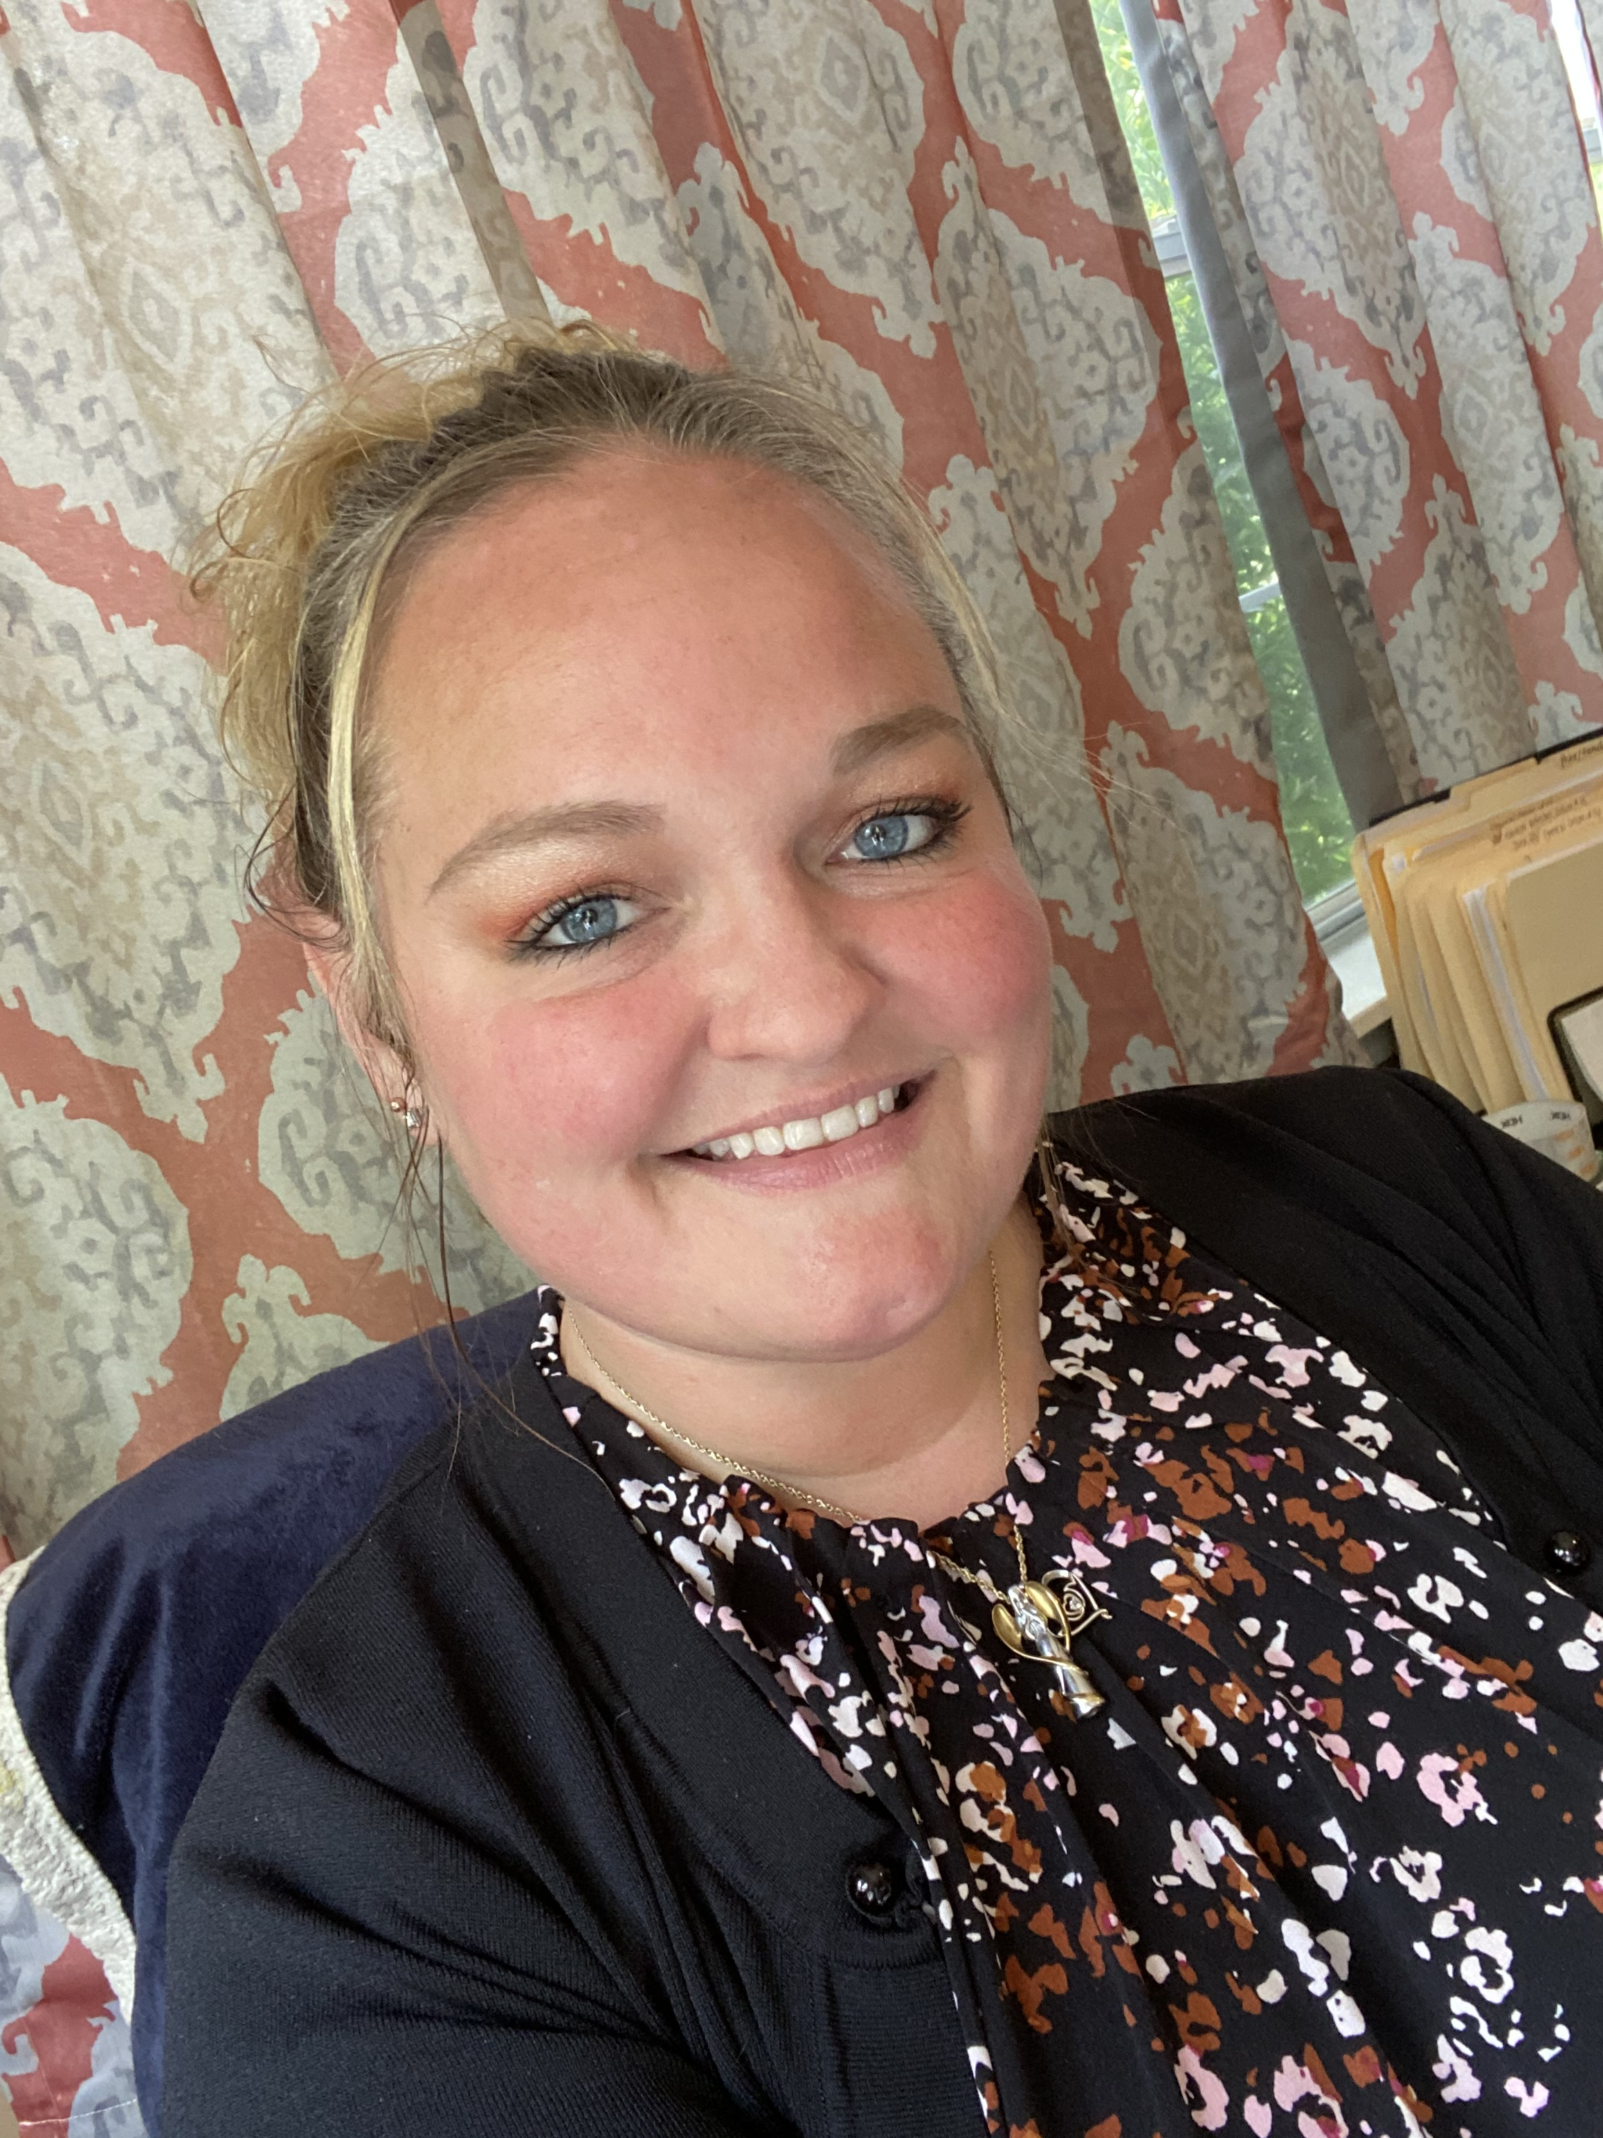
National Reunification Hero
Erin Thomas
Ms. Thomas has lived experience as a parent with child welfare involvement. Her parental rights were terminated and then reinstated after a period of incarceration and rehabilitation. She successfully reunited with her son in 2020. She is currently employed by the Georgia Mental Health Consumer Network where she serves as the Training Coordinator for the RESPECT institute of Georgia. Her role is to assist peers in developing their own stories of recovery through a five-day training process. She is a Certified Peer Specialist-Mental Health as well as a Certified Peer Specialist-Addictive Diseases. She is formally trained in both Youth and Adult Mental Health First Aid and has completed trauma-informed care and cultural competency training. She is a Whole Health and Wellness Coach. She is a mentor/advocate for her peers who are experiencing challenges related to mental health and substance use disorders. Ms. Thomas shared her inspiring story with Georgia's Division of Family and Children Services staff at our statewide virtual reunification event on June 8, 2021.

Slide 44

Reunification Events
June 4: Parent Advisory Council members discussed supporting reunification during our statewide Café 212 call
June 8: Virtual reunification celebration
June 15: “Reunification is an Action Word” presentation by Region 5
June 17: “Language as a Tool to Combat Stigma” presentation by DBHDD
June 22: “What to do When a Parent’s Progress Stalls Reunification” presentation by a parent attorney and a parent navigator
Several regional reunification celebrations

Slide 45
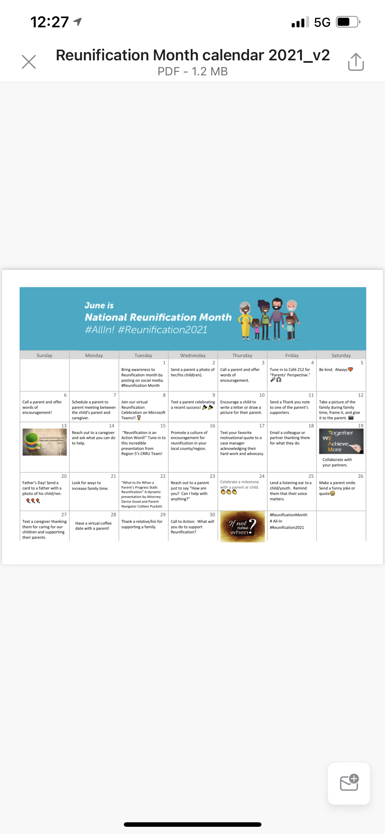

Slide 46

2021 Celebration of Excellence
Celebrating the Academic Accomplishments of our Youth!
As of June, 302 prospective graduates have been identified for the 2021 academic year. Out of the 302 prospective graduates submitted, 232 will be graduating from high school, college, technical school or receiving their GED.

Slide 47
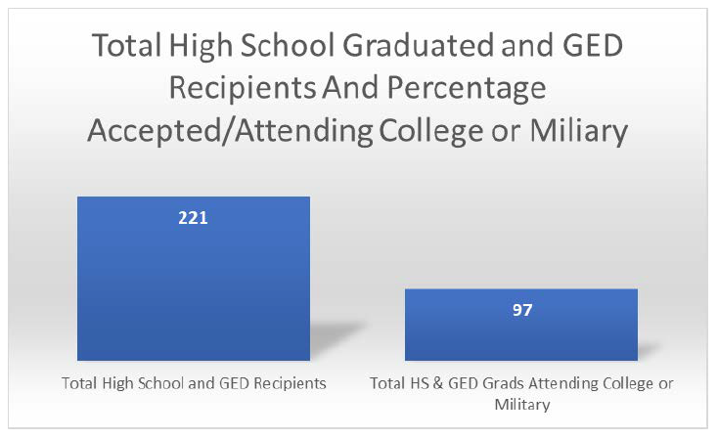
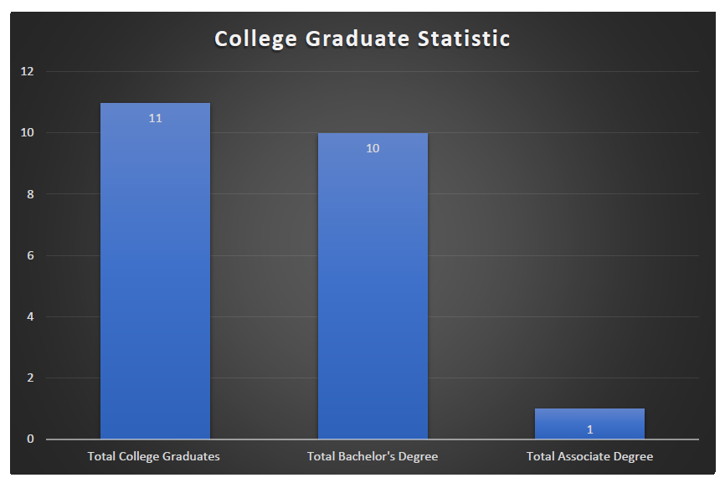
The data presented today was collected from youth, case managers, and other stakeholders by the GARYSE/Chafee Team in preparation for the 29 Annual Celebration of Excellence Graduate Recognition Program.

Slide 48
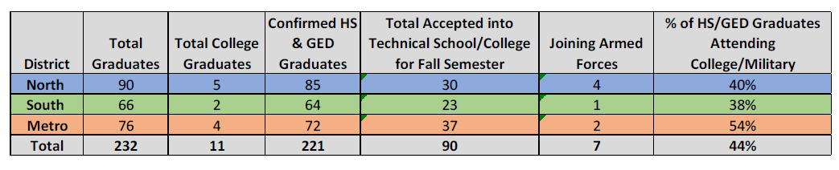
For more information about the GARYSE Chafee Independent Living Program, and the supports provided to older youth in foster care, please visit www.garyse-ilp.org.

Slide 49

Youth in Care Over 21 Years Old data from Care Solutions
78 Total
  2 at CCIs
  22 at CPAs
  1 at a TLP
  53 at ILPs.

Slide 50




Supporting Older Youth During Uncertain Times

Slide 51
GA RYSE Pandemic Relief Stimulus Funding
(Chafee Division X)
Division X of P.L. 116-260, the Consolidated Appropriations Act, 2021
ACYF-CB-PI-21-04
Funds were awarded to states to provide support to older youth in care who have been impacted by COVID 19.
Total Chafee Stimulus (Division X) Funding Allocated: $10,367,523.00.
Total Education and Training Voucher Stimulus Funding Allocated: $1,506,907.00
Temporary requirements for title IV-E agencies to allow youth over age 18 to remain in or re-enter foster care and suspension of the age and education/employment requirements for title IV-E foster care maintenance payments for youth;
John H. Chafee Foster Care Program for Successful Transition to Adulthood (Chafee program) Additional Funding and Flexibilities;
Education and Training Vouchers (ETV) Program Additional Funding and Flexibilities; and
Financial and Reporting Information for the Chafee and ETV Program Additional Funding

Slide 52
GA RYSE Pandemic Relief Stimulus Funding
(Chafee Division X)
Funds can be used to support Transitional Services such as:
Obtaining a high school diploma and post-secondary education
Career exploration, vocational training, job placement and retention
Training and opportunities to practice daily living skills (such as financial literacy training and driving instruction, substance abuse prevention, and preventive health activities (including smoking avoidance, nutrition education, and pregnancy prevention)
Financial assistance
Housing support
Counseling and other appropriate support and services

Slide 53
GA RYSE Pandemic Relief Stimulus Funding
(Chafee Division X) – GEORGIA’S PLAN
Our Georgia Plan Includes:
$400 Cash payment
Transportation Support
  Public Transit System Passes
  Ride Share Gift Cards
  Gas Cards
  Driver’s License fees (initial/renewal)
  Limited vehicle repairs – not to exceed $2500 youth (one-time payment directly to vendor on youth’s behalf)
  Vehicle Purchase Assistance – not to exceed $2500 per youth (one-time payment directly to vendor)
  Car Insurance – pre-pay up to six (6) months of car insurance – not to exceed $3600

Slide 54
GA RYSE Pandemic Relief Stimulus Funding
(Chafee Division X) – GEORGIA’S PLAN
Our Georgia Plan Includes:
$350 childcare credit
Housing Assistance
  Support eligible young adults with start-up housing costs to include:
    Deposit and up to 6 months rent (Includes first month’s rent) – not to exceed $8,000
    Utilities
    Furniture
  Rental Insurance
  Acquisition of vital documents (Driver’s License, ID, BC, SSN)

Slide 55
GA RYSE Pandemic Relief Stimulus Funding
(Chafee Division X) – GEORGIA’S PLAN
Our Georgia Plan Includes:
Youth Employment Opportunity
  Establishment of “Call Center” to support processing of General Assistance Stimulus payments
  10 – 15 part-time positions for young adults age 18+ with lived experience
  25hrs/wk @ $15/hr
  2 Full-time Team Lead positions for young adults age 18+ with lived experience
  1 ½ Project Managers – young adults age 18-21 with lived experience
  Young adults will be provided transportation assistance (ride share/gas cards)

Slide 56
OFI
Updates

Slide 57


Jon Anderson
Chief Deputy Division Director

Slide 58

Office of Family Independence
The Office of Family Independence’s goal is to strengthen Georgians by providing individuals and families access to services that promote self-sufficiency and independence.
Programs offered:
  Supplemental Nutrition Assistance Program (SNAP)
  Medical Assistance
  Temporary Assistance for Needy Families (TANF)

Slide 59
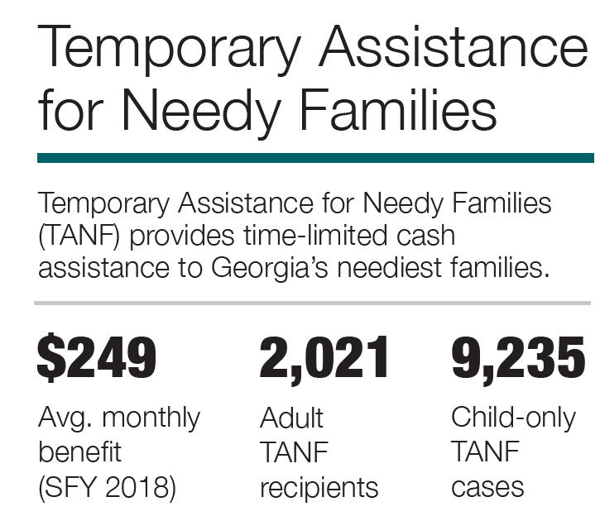
May 2021
Benefits Funding Source
$194 per month
Maximum Benefit for a Household of One
100% Federal
48K
Applications processed
112K
Renewals Processed
Supplemental Nutrition Assistance Program (SNAP, formerly Food Stamps)
SNAP provides nutrition benefits to supplement the food budget of needy families so they can purchase healthy food and move towards self-sufficiency.
$427
753K
$321M
Number of SNAP families
Monthly avg. SNAP benefits issued
(May 2021)
Notes:
Infographic for chart.

Slide 60


Economic Impact of SNAP in Georgia
SNAP dollar
Moody’s Analytics estimates that $1 in SNAP benefits generates $1.70 in economic activity.
SNAP households receive benefits on electronic benefit transfer (EBT) cards, which can be used only to purchase food at one of the 263,100 authorized retail locations around the country – including some 10,300 in Georgia.
SNAP dollar
Farmer
Farmer
Workers
& Goods
Economic
growth
Grocer

Slide 61
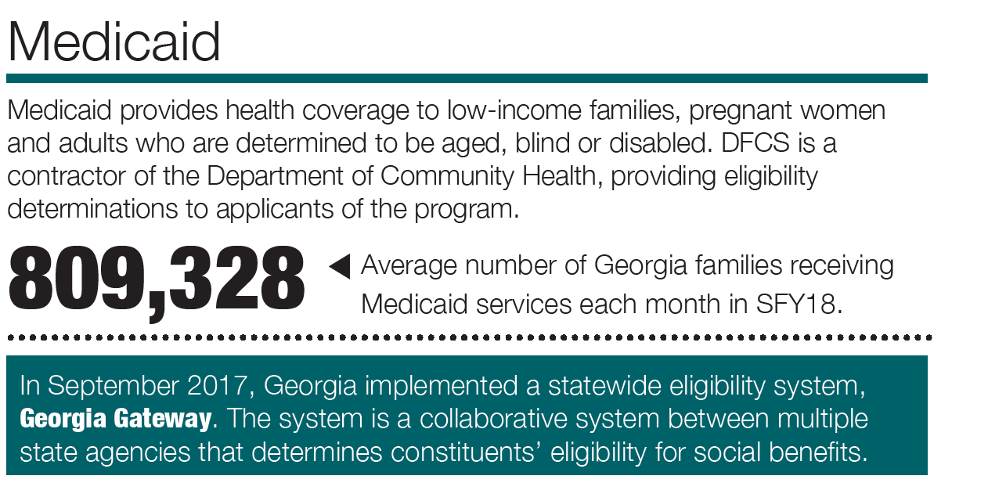
MEDICAID
Benefits Funding Source
Mix of Federal & State Funds
847,698
Number of Families
Number of individuals (May 2021)
2,226,634
Average number of children receiving PeachCare
182,578
1,008,560
(May 2021)

Slide 62
TANF
Funding Source
Total Issuance (May 2021)
99.98% Federal
.02% State
2,271
Applications Processed
$1,940,616
$259 6,123
1,357
Monthly
# of Mandatory Work Cases
(May 2021)

Slide 63
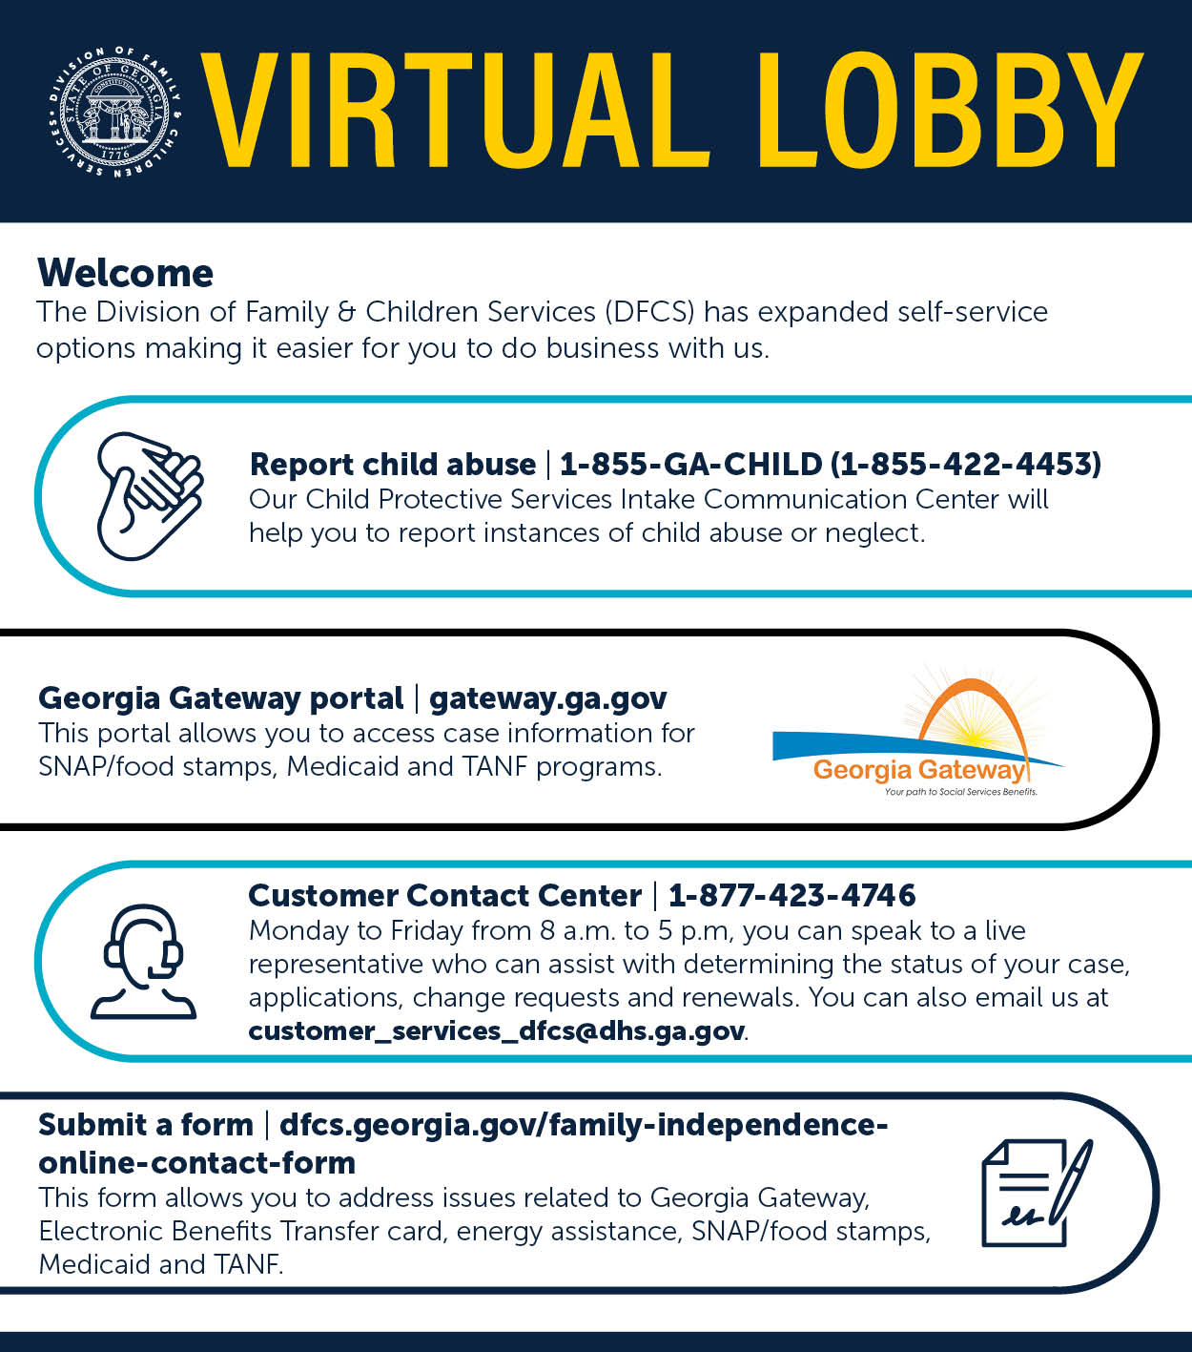

To apply for benefits
Online Self-Service options:
https://gateway.ga.gov/access/
For assistance with a paper application or other services, call the Customer Contact Center at:
Toll-Free: (877) 423-4746

Slide 64


Thank You
Georgia Division of Family
& Children Services
2 Peachtree Street, Suite 19-454
Atlanta, GA 30303

Slide 65
Board Discussion:
Committees

Slide 66
Board Member Regional Reports
Please briefly address the following:
-

Slide 67
Closing Remarks and Adjournment
Next board meeting: Sept 14, 2021

