Slide 1

State Advisory Board Meeting
May 11, 2021

Slide 2

Welcome and Introductions

Slide 3
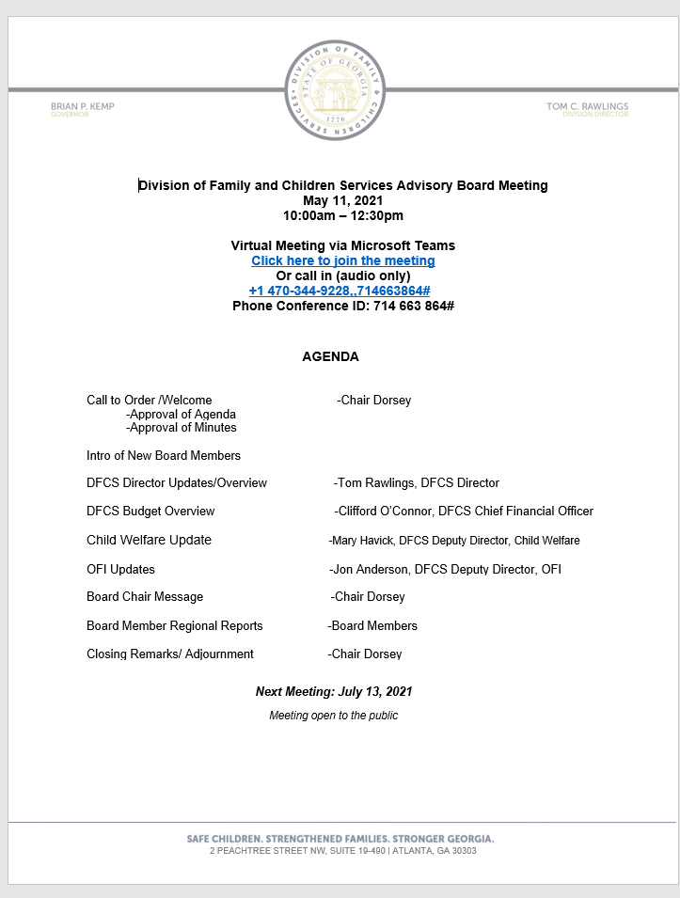
Approval of May 11, 2021 agenda

Slide 4
Approval of March 9, 2021 meeting minutes

Slide 5
Introduction of New SAB Board Members
Region 2: Dr. Fran Chastain
Region 11: Laci Gillis
Region 12: Allyson Christianson
Region 3: Randel Hambrick
Region 7: Deke Copenhaver
At Large #6: John Costley

Slide 6

Division Overview
Tom C. Rawlings
Director

Slide 7
Agency Vision
Safe Children. Strengthened Families. Stronger Georgia.
Agency Mission
We prioritize the safety of Georgia’s children in the decisions we make and the actions we take. We partner with families on their path to independence and build stronger communities with caring, effective and responsive service.

Slide 8
Agency Overview
Office of Child Welfare services:
Foster Care
Adoptions
Child Protective Services
Office of Family Independence services:
Supplemental Nutrition Assistance Program (SNAP)
Temporary Assistance for Needy Families (TANF)
Energy Assistance (LIHEAP)
Community Services Block Grant (CSBG)
Medical Assistance: Eligibility determinations for Medicaid, PeachCare for Kids, Planning for Healthy Babies
Notes:
Briefly describe each service we provide
CW
Foster care: temporary safe placements for children while we work with families toward reunification
Adoptions: permanency for children who cannot safely return home
Child Protective Services: investigation into safety concerns
OFI
Food stamps: food assistance, nutrition education and job assistance program.
Temporary Assistance for Needy Families: cash assistance.
Energy assistance: heating/cooling program.
Community Services Block Grant: funds allow States to provide a wide range of services to help ameliorate the causes and conditions of poverty. CSBG funding supports projects that lessen poverty in communities and address the needs of low-income individuals including the homeless and elderly. It also provides services and activities addressing employment, education, housing, nutrition, emergency services and health.
Eligibility for medical assistance programs: work in partnership with DCH to determine client's eligibility (per Federal standards) for these programs.

Slide 9
Agency Overview
DFCS has an office in each county*.
DFCS is open and serving Georgia’s population in all 159 counties. Although our physical presence may appear different, our virtual lobbies are open and we are serving people electronically and telephonically,
Counties are grouped into 14 regions.
Communities are served through two categories: Office of Child Welfare and the Office of Family Independence (OFI).
Regions form three districts across the state (child welfare) and seven districts across the state (OFI).
Child welfare district directors report to Deputy Director of Child Welfare.
OFI district directors report to the OFI Director of Field Operations.
*Note: The Stephens and Madison County Offices are currently operating out of adjacent facilities until a more permanent solution is identified
Notes:
Briefly discuss the setup of our offices/regions and how to locate on our website: www.dfcs.ga.gov >> select “County Offices” from the dropdown bar at the top to locate your local office.

Slide 10

Georgia Division of Family and Children Services Administration
Division Director
Tom C. Rawlings
Chief Operating Officer Carol Christopher
Division Director
Chief Operating Officer
Tom C. Rawlings
Carol Christopher
Director’s Confidential Assistant
Ambrea Henderson
Executive Assistant
Ashley Meriweather
Director’s Confidential Assistant
Executive Assistant
Ambrea Henderson
Ashley Meriweather
Chief Deputy Division Director
Office of Family Independence
Jon Anderson
Deputy Division Director
Child Welfare
Mary Havick
Chief Financial Officer
Clifford O'Connor
Chief Deputy Division Director
Office of Family Independence
Deputy Division Director
Child Welfare
Deputy Division Director
General Counsel
Chris Hempfling
Deputy Division Director Strategy, Innovation & Engagement
LaMarva Ivory
Senior Director of
Knowledge Management
Deputy Division Director Strategy, Innovation & Engagement
Senior Director of
Knowledge Management
Lee Biggar
Deputy Division Director
General Counsel
Chief Financial Officer
Lee Biggar
Jon Anderson
Mary Havick
Chris Hempfling
LaMarva Ivory
Clifford O'Connor
Executive Assistant Gwenell Strong
Executive Assistant Star Allen
Senior Director of
Accounting
Renita Jeffries
Executive Assistant
Executive Assistant
Paralegal/Executive Assistant
Tara Lowe
Executive Assistant
Salena M. Perry
Senior Director of
Accounting
Senior Director of
Operations
Darrell Braswell
Gwenell Strong
Star Allen
Paralegal/Executive Assistant
Executive Assistant
Senior Director of
Operations
Tara Lowe
Salena M. Perry
Renita Jeffries
Senior Director of
OFI State Operations
Carla Fairley
Darrell Braswell
Senior Director of
OFI State Operations
Senior Director of
CW Special Projects
Lon Roberts
Senior Director of
CW Special Projects
Deputy General Counsel Office of Family Independence George Dean
Senior Director of
Employee Recruitment, Retention
& Well-Being
Sekema Harris-Harmon
Senior Director of
Senior Director of
Budget
Christopher Wright
Carla Fairley
Deputy General Counsel
Office of Family Independence
Senior Director of
Budget
Senior Director of Communications
Jessica Loeding
Employee Recruitment, Retention
Senior Director of Communications
Lon Roberts
George Dean
& Well-Being
Christopher Wright
Jessica Loeding
Senior Director of
Customer Contact Center
Nixie Ann Gumbs
Sekema Harris-Harmon
Senior Director of
Customer Contact Center
Senior Director of
Practice & Program Guidance
Colleen Mousinho
Deputy General Counsel Child Welfare
Judy Holdaway
Senior Director of
Practice & Program Guidance
Senior Director of
Strategic Partnership and Messaging
Christopher Perlera
Director of
Contract Administration
Debra Lookabill
Deputy General Counsel
Senior Director of
Strategic Partnership and Messaging
Director of
Contract Administration
Nixie Ann Gumbs
Colleen Mousinho
Child Welfare
Judy Holdaway
Debra Lookabill
Senior Director of
System Integrations and Implementation
Mona Jackson
Christopher Perlera
Senior Director of
System Integrations and Implementation
District Director-Metro James Binnicker
Assistant General Counsel Roshonda Sutton
Director of
Fiscal Services
Adrian Owens
Mona Jackson
District Director-Metro
Assistant General Counsel
Project Director Donna Pettigrew-Jackson
Director of
Fiscal Services
James Binnicker
Roshonda Sutton
Project Director
Senior Director of
Field Operations
Mary Beth Lukich
Donna Pettigrew-Jackson
Adrian Owens
Senior Director of
Field Operations
District Director-South LaCharn Dennard
Civil Rights and ADA Coordinator Katherine Cadena
District Director-South
Project Director NuTrelle Toodle
Director of
Revenue Maximization
Jo Ann Wheeler
LaCharn Dennard
Civil Rights and ADA
Director of
Revenue Maximization
Mary Beth Lukich
Coordinator
Project Director
Senior Director of
Quality Operations
Wesley Merritt
District Director-North Ashley Parham
Katherine Cadena
NuTrelle Toodle
Jo Ann Wheeler
Senior Director of
Quality Operations
Wesley Merritt
District Director-North
Effective 04/05/2021
Ashley Parham
Notes:
Briefly describe the role of your executive team

Slide 11
Office of Family Independence
Number of individual receiving SNAP in SFY 2020: 1,396,878
Average SNAP benefit per household in SFY 2020: $300
Number of families receiving medical coverage in SFY 2020: 847,698
Child-only cases receiving TANF in SFY 2020: 7,783
Notes:
Source: DHS data page
Discuss these figures in the context of volume of families in need we serve every day.

Slide 12
Office of Child Welfare
Number of children in foster care program on average at any one point in time, representing a decrease of 10% from SFY 2019: 18,449
Number of children adopted in SFY 2020: 1,421
34,970 reports of abuse or neglect of children were investigated by CPS staff in SFY 2020
DFCS implemented strategies that reduced the child foster care population (<18 years old) by more than 8.5 percent in FY 2020, decreasing from 13,053 to 11,919 (as of June 30, 2020).
Notes:
Source: DFCS child welfare data team
Discuss our work with families to find safety and permanency for all children. Explain what the numbers here mean.

Slide 13
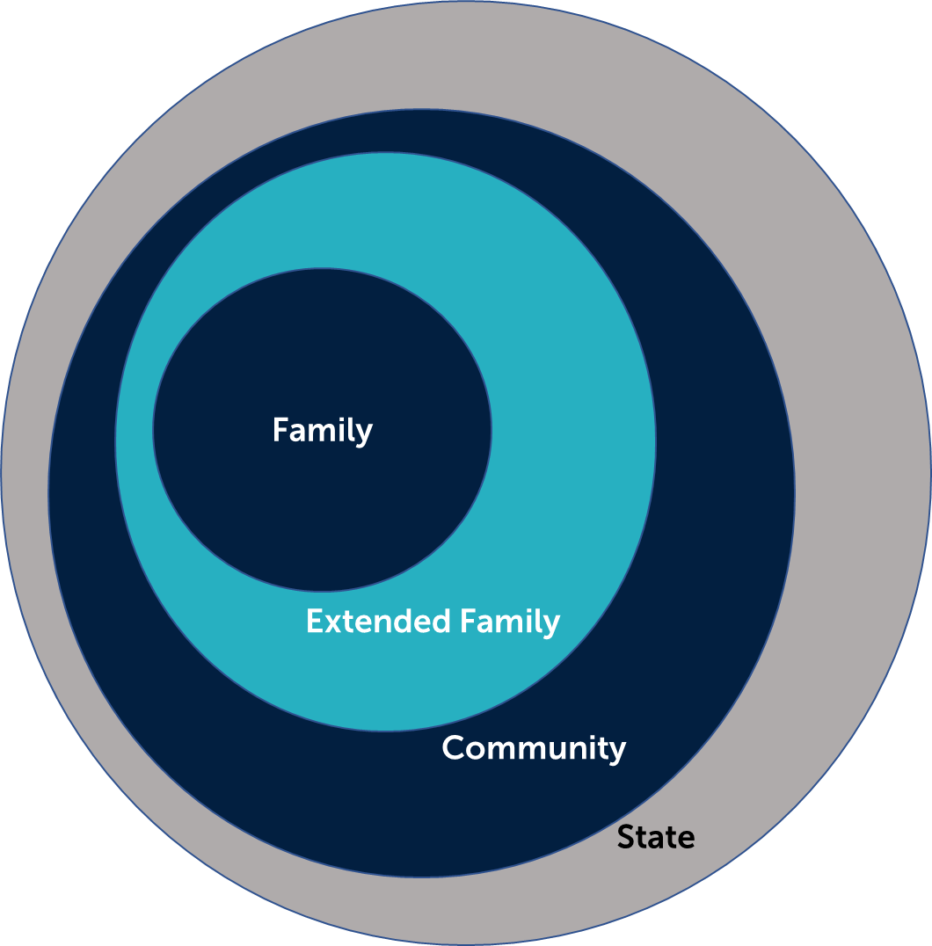
Circle of Support and Intervention

Slide 14
Major Priorities
Balancing the Workload:
Simplifying
Focus on core responsibilities
Making caseloads manageable
Working more closely with community partners and other agencies
Bolstering the Workforce:
  Struggle in this economy
  Continual recruiting
  Just Culture
  Dare to Lead Training
  Staff Survey
  Support

Slide 15
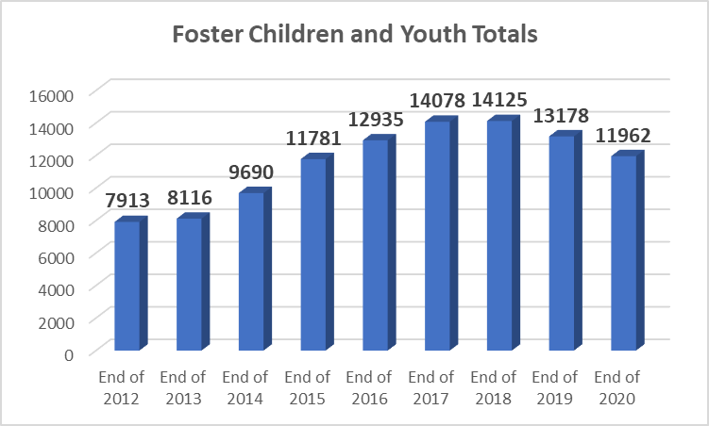

Slide 16

Georgia Update
Notes:
High-level overview of FFPSA
Discuss timeline for implementation.
We are working with a public relations agency to build our communication strategy around FFPSA.

Slide 17
Questions?
Contact me:
Tom.Rawlings@dhs.ga.gov

Slide 18

DFCS Budget
Overview

Slide 19
SFY22 Program Budgets - HB81
 |  |  | Agency Funds or |  | Order by $
Program Budget | State Funds | Federal Funds | Intra State Transfer | Total Funds | Size
Adoptions Services | $ 41,783,695 | $ 82,875,243 |  | $ 124,658,938 | 4
After School Care | $ 4,727,964 | $ 15,500,000 |  | $ 20,227,964 | 7
Child Abuse and Neglect Prevention | $ 2,270,583 | $ 6,561,869 |  | $ 8,832,452 | 10
Child Welfare Services | $ 195,288,974 | $ 203,183,881 | $ 134,146 | $ 398,607,001 | 1
Community Services |  | $ 16,110,137 |  | $ 16,110,137 | 9
Energy Assistance |  | $ 55,320,027 |  | $ 55,320,027 | 5
Federal Eligibility Benefit Services | $ 117,030,156 | $ 202,351,831 | $ 641,750 | $ 320,023,737 | 3
Out of Home Care | $ 281,138,788 | $ 88,272,126 |  | $ 369,410,914 | 2
Support for Needy Families - Basic Assistance | $ 70,000 | $ 36,453,008 |  | $ 36,523,008 | 6
Suport for Needy Families - Work Assistance | $ 100,000 | $ 18,735,330 |  | $ 18,835,330 | 8
 |  |  |  | $ -
 |  |  |  | $ -
Total | $ 642,410,160 | $ 725,363,452 | $ 775,896 | $ 1,368,549,508
 | 47% | 53%

Slide 20
Child Welfare
Updates

Slide 21
Celebrating National Foster Care Month
The objective of National Foster Care Month is to raise public awareness of how Georgia’s Child Welfare system supports families with services that strengthen and empower their ability to stay together.
Each May, we take time to acknowledge foster parents, family members, volunteers, mentors, policymakers, child welfare professionals, and other members of the community who help children and youth in foster care find permanent homes and connections.

Slide 22


Theme: Pinnacle Partnerships-Celebrating our selfless players at the highest level!
Calendar of Events
Tuesday May 4th-Wear Blue Day to build awareness about fostering
Friday May 7th-CRRU Director, DaJari Patterson and OPM Director Dr. Shaun Johnson host CAFÉ 212
Wednesday May 17th-NFCM live event hosted by CRRU featuring Caregiver Navigators and honoring our Caregivers of the Year honorees
Thursday May 27th- NFCM Celebration at Truist Park Guest Speaker: Greg McMichael-Retired Braves Pitcher
Regional Celebrations
Each region will also host regional celebrations for their caregivers throughout the state.
Social Media
Caregivers of the Year honorees will be prominently featured on the DFCS website throughout the month of May.

Slide 23

Celebrating National Reunification Month
Celebrated each year in June, National Reunification Month recognizes the people and efforts around the country that help families stay together.

Slide 24
National Reunification Month 2021
Theme: All In! Reunification 2021
Calendar of Events
Friday June 4th- “Go Red for Reunification”
Friday June 4th- Reunification Unit hosts Café 212-A facilitated discussion with Parent Advisory Council member Colleen Puckett and Parent Attorney Darice Good
Monday June 8th- Virtual Reunification Month Celebration hosted by Reunification Director, Samantha Walker
TBD-Reunification Director will participate in the Caregiver Coaching Academy to discuss how caregivers can support birth families
Regional Celebrations
Each region will also host regional celebrations for their caregivers throughout the state.
Social Media
Reunification Heroes will be featured via Social Media and email blasts throughout the month.

Slide 25


Reunification Month webinars
GA Parent Association to discuss parent support groups
DBHDD Addiction Recovery Support Centers for parents with substance use disorders
Federation for Families overview
“Reunification-What happens when a parent stalls?” by Parent Attorney Darice Good
“Reunification is an Action Word” by Region 5 CRRU Administrator Audrey Brannen and CRRU Supervisor Adrienne Forchilli

Slide 26
Family Support Redesign Pilot
These first-ever pilots in Georgia involve three State of Hope sites across our state (located in Muscogee, Gwinnett and Union counties).
The pilot sites receive referrals that would otherwise have been handled by DFCS as a Family Support case, or even have been potentially screened out of the system when no credible, current allegation of abuse is found.
The pilots began in March 2021.

Slide 27
Family Support Redesign Pilot
The children and families that will participate in these pilots will be cases related to neglect, poverty and/or lack of resources.
Cases of alleged child abuse will be handled directly by DFCS and will not be considered for these pilot programs.
For families referred to the pilot sites, the agency will close our case at the intake stage as screened out and referred to another agency.
The pilot sites will not send outcomes back to DFCS on interventions or services on an individual level.

Slide 28
Family Support Redesign Pilot
Parents receive a letter informing them of the referral to the community agency. The letter was drafted by the DFCS Parent Advisory Council.
Families in the pilots will be contacted by service organizations and offered services.
State of Hope partners:
  Union County Family Connection
  Foster Care Alliance/Mother’s Advocacy Project
  Columbus Community Action Agency

Slide 29
Family Support Redesign Pilot
These pilots contemplate the evolution of DFCS practice under the opportunities provided through the federal Family First Prevention Services Act (FFPSA): partnering with communities, investing in families early to strengthen them, and ensuring kids are well-cared for, while safely preventing the trauma and additional expense of investigations and removals now and in the future.

Slide 30
OFI
Updates

Slide 31


Jon Anderson
Chief Deputy Division Director

Slide 32

Office of Family Independence
The Office of Family Independence’s goal is to strengthen Georgians by providing individuals and families access to services that promote self-sufficiency and independence.
Programs offered:
  Supplemental Nutrition Assistance Program (SNAP)
  Medical Assistance
  Temporary Assistance for Needy Families (TANF)

Slide 33

Supplemental Nutrition Assistance Program
The Supplemental Nutrition Assistance Program (SNAP), also known as the food stamp program, provides low-income Georgians help with their monthly food costs.
Based on guidance from the USDA Food and Nutrition Services, the SNAP program delivers a host of programs and services to families in need.

Slide 34
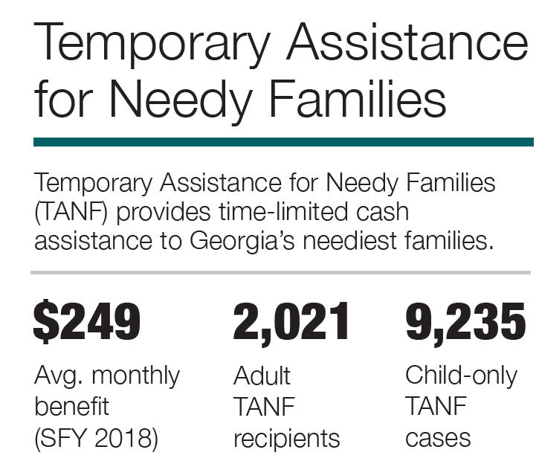
STATE FISCAL YEAR (SFY) 2020
Funding Source
$194 per month
Maximum Benefit for a Household of One
100% Federal
$300
Average Benefit Per Household
1,396,878
Average monthly # of SNAP individuals
Supplemental Nutrition Assistance Program (SNAP, formerly Food Stamps)
SNAP provides nutrition benefits to supplement the food budget of needy families so they can purchase healthy food and move towards self-sufficiency.
$300
118,054
107,543
Number of SNAP Works Participants
Monthly avg. number of Senior SNAP cases
(SFY 2020)
Notes:
Infographic for chart.

Slide 35


Economic Impact of SNAP in Georgia
SNAP dollar
Moody’s Analytics estimates that $1 in SNAP benefits generates $1.70 in economic activity.
SNAP households receive benefits on electronic benefit transfer (EBT) cards, which can be used only to purchase food at one of the 263,100 authorized retail locations around the country – including some 10,300 in Georgia.
SNAP dollar
Farmer
Farmer
Workers
& Goods
Economic
growth
Grocer

Slide 36
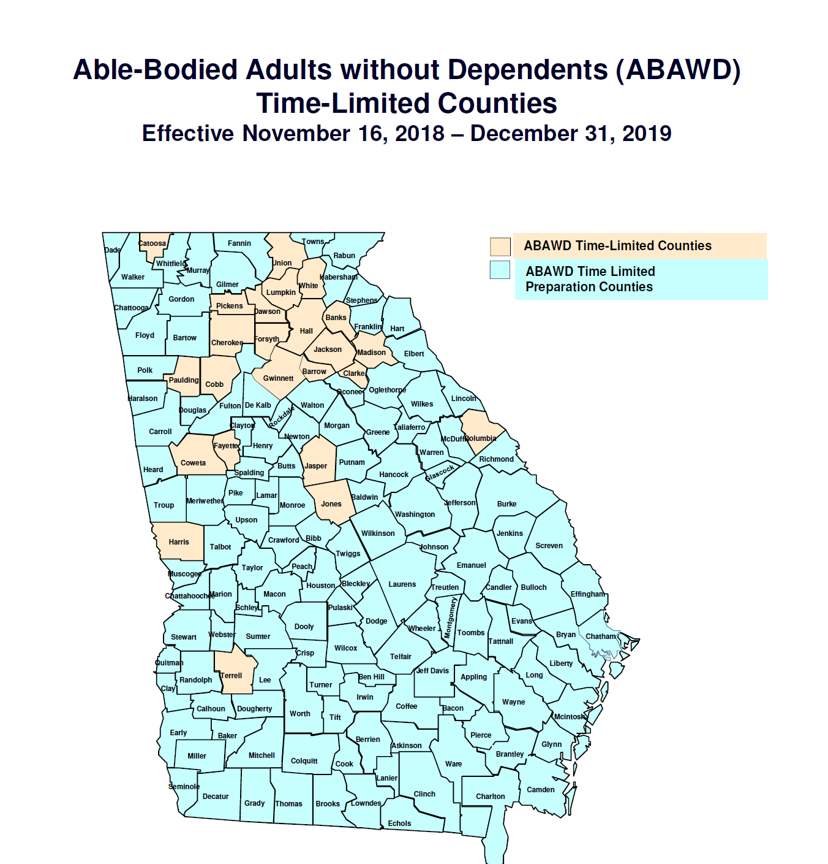
SNAPWorks Time Limit Counties
Due to COVID -19, the State agency requested and was approved to waive the Able-Bodied Adults Without Dependents (ABAWDS) time limit throughout the State from July 1, 2020, to June 30, 2021.
WAIVED DUE TO COVID-19

Slide 37

Medicaid
Medicaid provides health coverage to low-income families, pregnant women and adults who are determined to be aged, blind or disabled. DFCS is a contractor of the Department of Community Health, providing eligibility determinations to applicants of the program.

Slide 38
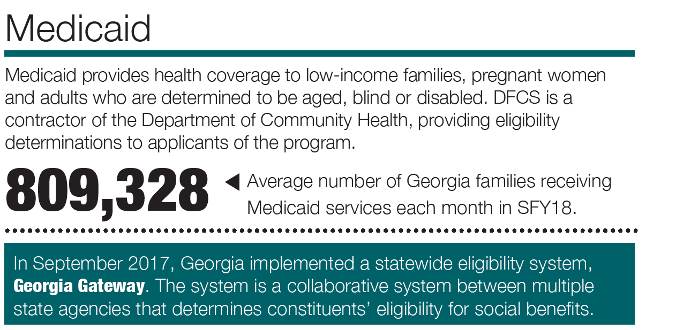
MEDICAID
Funding Source
Mix of Federal & State Funds
847,698
Average Number of Families
Average number of children
1,111,717
Average number of children receiving PeachCare
132,342
847,698
(SFY 2020)

Slide 39

Temporary Assistance for Needy Families
The Temporary Assistance for Needy Families (TANF) program was created in 1996 as part of welfare reform legislation. The program provides time-limited cash assistance to Georgia’s neediest families.

Slide 40
TANF
Funding Source
12,613
Average Total Cases
99.98% Federal
.02% State
$256
Average Benefit Amount per Month
$256 7,783
892
Average monthly
# of caregivers
(SFY 2020)

Slide 41



Low Income Home Energy Assistance Program (LIHEAP)

Slide 42
LIHEAP
Regular Energy Assistance
Crisis Intervention Assistance
Cooling Assistance
Weatherization
Program administered by
Community Partners Statewide
Four Primary Services:
100% Federal
Funding Source
193,528 Households Served
FY 2020
FY 2018
140,795 Households Served
FY 2019
191,435 Households Served
In FY 2020 energy assistance program kept nearly 200,000 Georgians safe and healthy in extreme weather.
Georgia received $44,684,626.00 of federal funding for LIHEAP CARES. LIHEAP CARES Program began on July 1, 2020 in Georgia.

Slide 43


Community Services Block Grant (CSBG)

Slide 44

CSBG
Funding supports a wide range of services to help reduce the causes and conditions of poverty
Program administered by
Community Partners Statewide (24)
Services:
100% Federal
Funding Source

Slide 45

COVID-19
Agency Pandemic Response
January 2020
SNAP online application
launched in
Georgia Gateway
March – April 2020
July – November 2020
P-SNAP
Renewal extensions
ABAWD requirement suspension
December 2020 – March 2021
P-SNAP
Renewal extensions
ABAWD req. suspension
Online Purchasing Program
15% SNAP Increase
SNAP Student pandemic allowances
March and beyond. . .
May – June 2020
P-SNAP
Renewal extensions
ABAWD req. suspension
Online Purchasing w/ in-store pickup
Online Purchasing w/ EBT delivery
P-SNAP
P-SNAP
Renewal extensions
ABAWD req. suspension
Online Purchasing Program
LIHEAP Cares
P-EBT
Renewal extensions
ABAWD req. suspension
Online Purchasing Program
15% SNAP Increase
SNAP Student pandemic allowances
LIHEAP Cooling
TANF Cares
Georgia Pathways

Slide 46
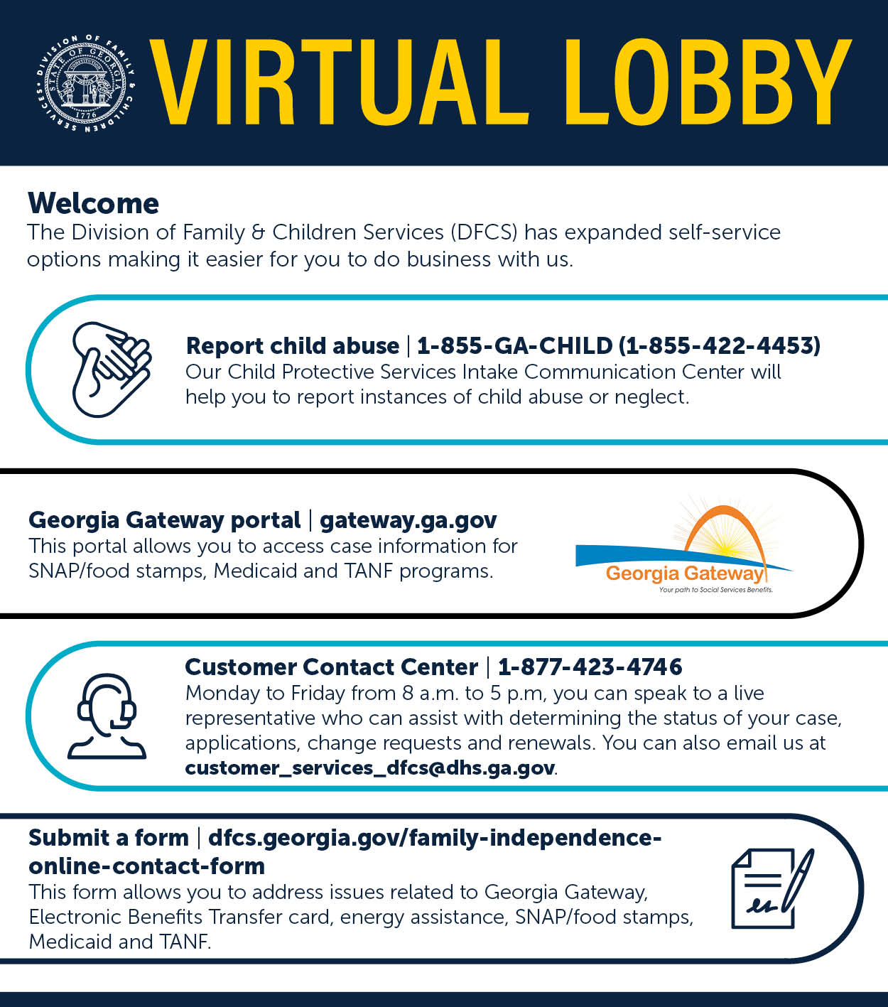

To apply for benefits
Online Self-Service options:
https://gateway.ga.gov/access/
For assistance with a paper application or other services, call the Customer Contact Center at:
Toll-Free: (877) 423-4746

Slide 47


Thank You
Georgia Division of Family
& Children Services
2 Peachtree Street, Suite 19-454
Atlanta, GA 30303

Slide 48
Board Chair Message

Slide 49
Board Member Regional Reports
Please briefly address the following:
-

Slide 50
Closing Remarks and Adjournment
Next board meeting: July 13, 2021

