Slide 1

State Advisory Board Meeting
January 11, 2022

Slide 2


Slide 3
Approval of January 11, 2022 agenda

Slide 4
Approval of November 9, 2021 meeting minutes

Slide 5

Department of Human Services
Division of Family & Children Services
State Advisory Board
Director’s Report
Candice L. Broce

Slide 6
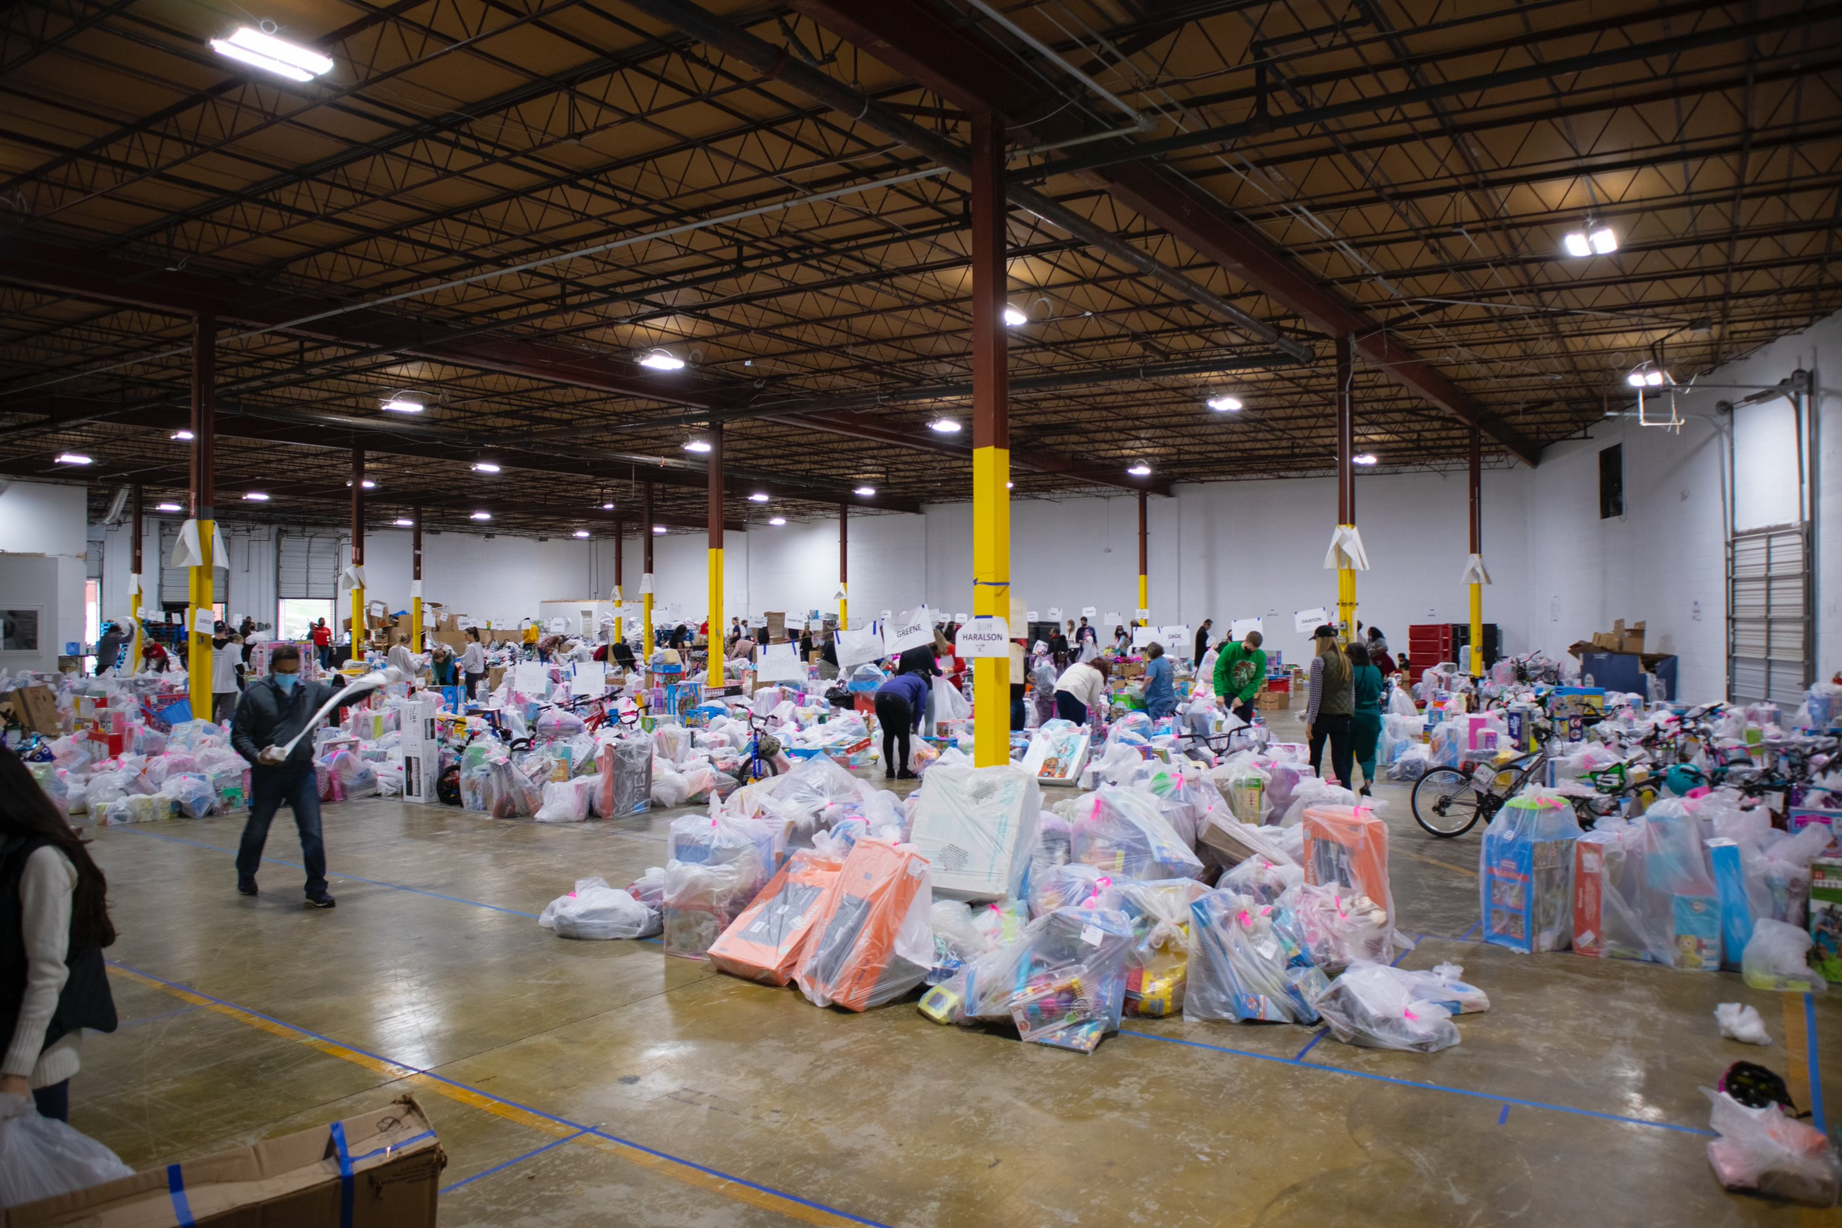
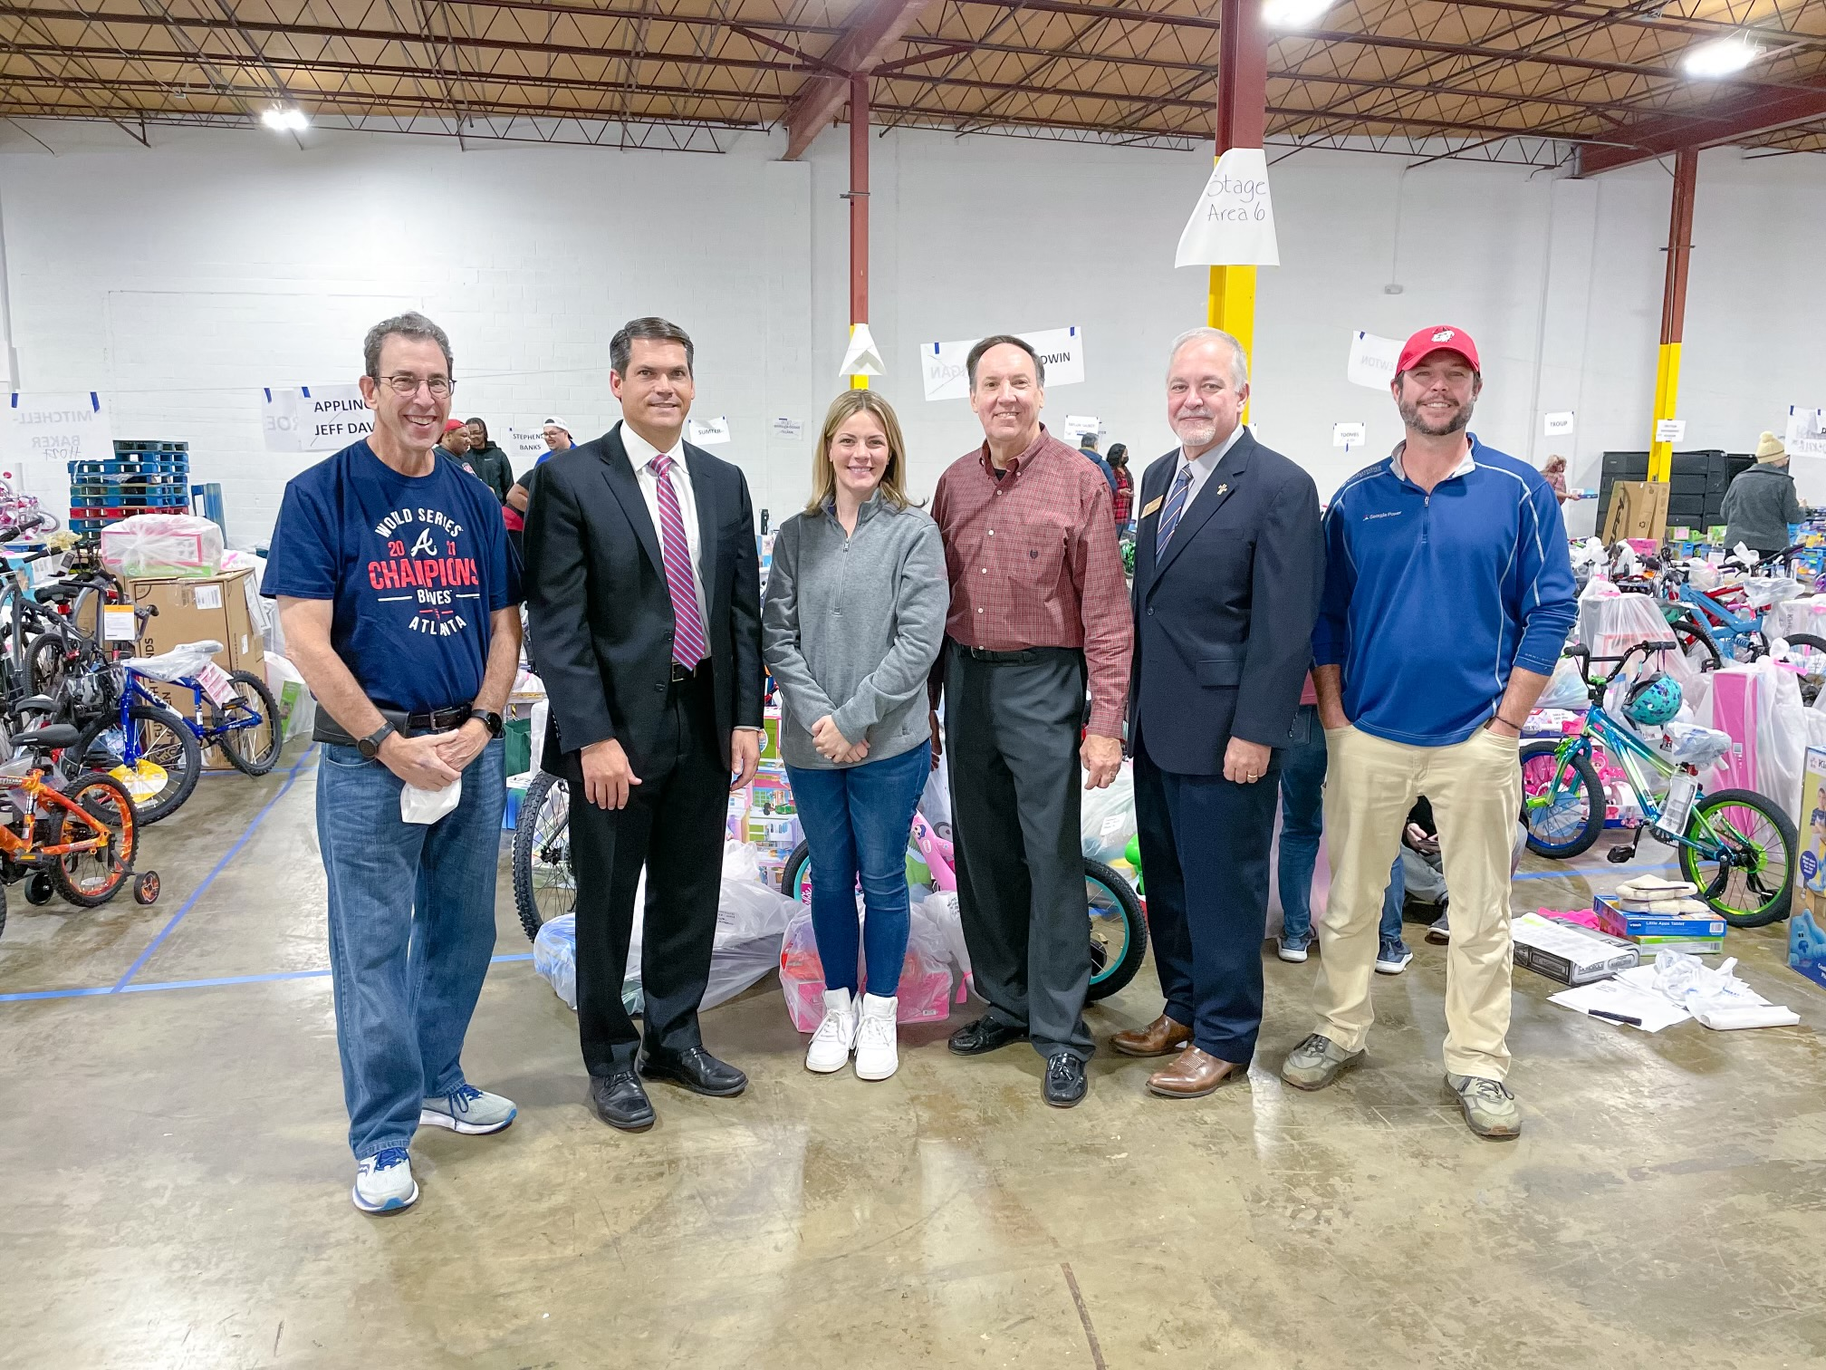
Clark’s Christmas Kids
Raised over $1.5 million, providing 25,500+ gifts and successfully filling the wish lists of over 8,500 Georgia children in foster care
Notes:
Clark’s Christmas Kids
Christmas morning was a little merrier for Georgia’s children in foster care this year, thanks to generous donations from so many people and organizations. The Clark’s Christmas Kids Program raised over $1.5 million, providing more than 25,500 gifts and filling the wish lists of more than 8,500 children in foster care. Our agency worked with radio host Clark Howard, WSB-Radio, St. Vincent de Paul, and other community partners to make this happen, using an entirely virtual platform for the second year in a row.

Slide 7
Updates
Annual Report
  Published on Dec. 31, 2021
  View the report on our homepage: dhs.georgia.gov
Personnel Changes
2022 Legislative Session
  Convenes on Jan. 10, 2022
  Questions? Email Matthew Wosotowsky matthew.wosotowsky.@dhs.ga.gov
Our Priorities in 2022
Notes:
Annual Report
On Dec. 31, 2021, we published our Annual Report for State Fiscal Year 2021 (SFY 21), which supports Gov. Kemp and First Lady Marty Kemp’s goals for the state and highlights existing programs and services; gives a snapshot of the number of Georgians served during SFY 21; and demonstrates our agency’s unified vision of building stronger families for a stronger Georgia. View the report on our homepage: https://dhs.georgia.gov/.
Personnel Changes
In December, Breanna Thomas, who previously served as the Department’s Assistant Deputy Commissioner for Operations, was promoted to Deputy Commissioner of State Programs & Human Resources following Tanguler Gray’s retirement.
Additionally, long-time DFCS veteran Audrey Brannen was promoted into a newly created role focused exclusively on identifying better placements for youth with complex needs. In this capacity, she will continue to reduce the agency’s use of temporary placements in local offices and hotels by working closely with providers to tailor options to each child’s specific needs. As we strive to end “hoteling,” we are thrilled to have her in such an important role.
2022 Legislative Session
The legislative session convened on January 10th and is scheduled to adjourn on March 31, 2022. Matthew Wosotowsky, our new Legislative Director, and his team hold the primary responsibility to develop and implement strategies to advance the Department’s legislative initiatives and other interests relating to the Georgia General Assembly. Matt can be reached by email at matthew.wosotowsky@dhs.ga.gov.
In the coming days, the Governor will release his budget recommendations for Amended State Fiscal Year 2022 and State Fiscal Year 2023. Although our agency did not submit any formal requests, we may still see changes in our budget. The agency has worked closely with the Governor’s Office to further strengthen a child’s right to counsel as required by Georgia statute and is currently working with potential legislative sponsors to introduce this important legislation.
Our Priorities in 2022
Over the past few months, I have worked with my team to brainstorm our priorities in this new year. We are working on several child welfare-related technology projects, including SHINES upgrades to allow for caseworker mobility in the field; a new portal for staff, foster parents, and providers to better coordinate care, transportation, appointments, and similar needs; and a new module for foster family recruitment and training.
We are also working diligently to make life easier on the field. I have received excellent feedback from region and county staff on how we could ease their administrative burdens and dispatch resources to the right places. For example, just a few days ago, Robin Herron placed an order for hundreds of car seats and pack-n-plays for county offices. We are also working on getting key vendors – like Walmart and Amazon – added as state vendors so our staff can directly submit purchase orders instead of using business checks. These changes seem small, but incremental progress over time makes a huge impact. If you have ideas, send them my way.
Lastly, our agency is working closely with the Governor’s Office and public health officials to identify and deploy contracted direct care staff to providers struggling with COVID-related workforce shortages. We hope to announce more details in the coming days.

Slide 8
Questions?
Director Candice.Broce@dhs.ga.gov
Chief of Staff Craig.Foster@dhs.ga.gov
Deputy Chief of Staff Chris.Hempfling@dhs.ga.gov

Slide 9


Matt Wosotowsky
Legislative Affairs Director

Slide 10
2021-2022 Legislative Session
Biennial Session
  2nd year
  Legislation introduced last year still in process
  New bills also being introduced
No more than 40 “working days”
Legislative Process
  State of the Union
  MLK Jr. Week
  Crossover Day
  Sine Die
2022 in particular
  Election Year
    All constitutional officers as well as everyone in General Assembly on the ballot
    Redistricting
Key Players
  Governor Brian Kemp
    Floor Leaders
  Lt. Gov Geoff Duncan
    Speaker Pro Temp and Committee Chairs
  Speaker David Ralston
    Leadership Team and Committee Chairs

Slide 11
2021-2022 Legislative Session
Committees of significance to DHS and DFCS this session
Appropriations (House and Senate)
Juvenile Justice (House)
Judiciary Non-Civil (House) and Judiciary (Senate)
Health and Human Services (House and Senate)
Education (House) & Education and Youth (Senate)

Slide 12
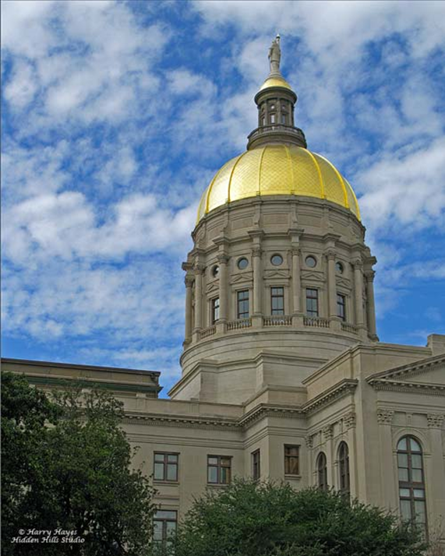
Proposed Legislation

Slide 13
  Description: Right to Counsel (18-21 year olds)
  Rule/Law: Title 15
  Recommendation:This purpose of this proposal is to provide a right to counsel for anyone 18-21 years of age receiving extended care youth. This solution can be provided by addressing a current concern in O.C.G.A. 15-11-103(b). That sentence should read: The court shall appoint an attorney for an alleged dependent child and any child receiving extended care youth services from DFCS.
  Need For Change: At the current time, a uniform practice throughout the state does not exist regarding the appointment of youth receiving extended youth services from DFCS. This clarification is important, because so long as the youth receives EYS, the juvenile court continues to have jurisdiction over the child and holds regular review hearings. For these youth it is important for them to have legal representation during these hearings to ensure they have an advocate present.

Slide 14
Questions
Matt Wosotowsky
DHS Director of Legislative Affairs
matthew.wosotowsky@dhs.ga.gov
404.217.8298
Notes:
It changes the minimum age of adoption from 25 to 21.

Slide 15
Mary Havick
Deputy Commissioner
Child Welfare

Slide 16

Family Support Cases are opportunities to assist families where concerns exist but can be managed with only minimal DFCS involvement, usually through referrals to community services. Data Source: Shines

Slide 18
Family Preservation is a program designed to continue working with a family where safety concerns have been identified with the children remaining in the home. Data Source: Shines

Slide 19
This chart shows the number of children in an active Family Preservations cases at the end of the month. If not for this program, many of these children would otherwise be in foster care. Data Source: Shines

Slide 20
Voluntary Kinship is an innovation used by DFCS over the past several years to provide a safe haven for children involved in an investigation before a final determination can be made regarding the need for foster care. Data Source: Shines
Notes:
Can remove this chart (as requested).

Slide 21
This chart shows the number of children in foster care at the end of each month. Efforts are made immediately upon entry to pursue reunification when possible. A portion of the decline in the number of foster children over the past two years is due to the efforts by DFCS to exhaust all possible alternatives to entry. Data Source: Shines

Slide 22
This chart compares for each month the number of entries and exits into foster care. (November data subject to change due to late date entry). Data Source: Shines

Slide 23
Finding a for ever family for each child is the goal of DFCS when it is clear that reunification will not be in the best interest of the child. These adoption counts by month show the continuous effort undertaken to help foster children achieve this goal. Data Source: Shines

Slide 24
Mary Havick
Deputy Commissioner
Child Welfare
mary.havick@dhs.ga.gov

Slide 25
Jon Anderson
Deputy Commissioner Family Independence

Slide 26
1,402,713 Active Unduplicated Families in November 2021. Source: DFCS Transparency Data

Slide 27
Average Caseload Size in November was 963.
Source: DFCS Transparency Data

Slide 28
Frontline Staffing level processing cases was 1,457 in November.
Source: DFCS Transparency Data

Slide 29
SNAP Issuance in November was $379,227,750. Average issuance per family was $497.

Slide 30
Total SNAP Families in November was 762,758

Slide 31
SNAP applications processed in November was 63,208 and renewals processed was 77,791.
Data Source: DFCS Transparency Data

Slide 32
Active Medical Assistance families in November was 1,054,059
Data Source: DFCS Transparency Data

Slide 33
Total Medical Assistance Applications processed in November was 48,163.
Data Source: DFCS Transparency Data
Notes:
Can remove this chart (as requested).

Slide 34
Average TANF Issuance in November was $1,878,130. Average issuance was $261.
Data Source: DFCS Transparency Data

Slide 35
Data Source: DFCS Transparency Data

Slide 36
Data Source: DFCS Transparency Data

Slide 37


Thank You
Georgia Division of Family
& Children Services
2 Peachtree Street, Suite 19-454
Atlanta, GA 30303

Slide 38

Board Chair Vision & Expectations

Slide 39


Slide 40
Board Member Regional Reports
Please briefly address the following:
-

Slide 41


