Slide 2
Georgia Division of Family and Children Services
Office of Prevention and Family Support
First Steps Georgia (FSG) Statement of Need (SoN) Overview
April 2016

Slide 3
Let’s Get Started!
Georgia Division of Family and Children Services (DFCS)
Mission: to strengthen Georgia by providing individuals and families access to services that promote self-sufficiency, independence and protect Georgia’s vulnerable children.
Office of Prevention and Family Support (OPFS)
- Primary Goal: to work in partnership with community-based organizations committed to reducing the incidence of child abuse and neglect and improving the overall health and well- being of Georgia’s children and families.

Slide 4
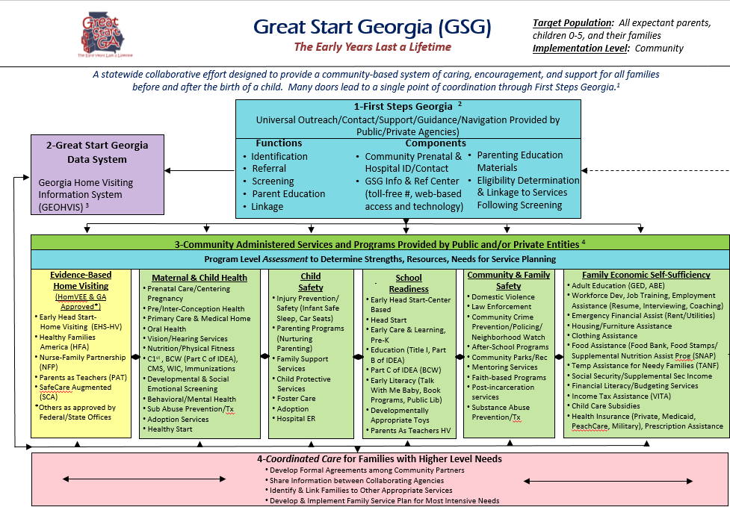
First Steps Georgia Overview

Slide 5
First Steps Georgia Overview
Through this SoN, the goal is to engage communities in planning, implementing, and sustaining universal parent support services through contract funding of First Steps Georgia in their communities.
Great Start Georgia (GSG) is first and foremost a vision for how communities can provide a welcome to every child; make available natural supports for all expectant parents and for all families with children birth to five; provide basic parenting information and resources; and link families with more intensive services when needed.
At its heart, GSG creates a community culture of caring, encouragement, and support for all families before and after the birth of a child through age five.

Slide 6
First Steps Georgia Summary
The mission of First Steps Georgia is to provide universal, free and voluntary support services for all expectant parents and children ages birth to five and their families.
Goal 1: Provide current information on topics of interest and relevance to expectant parents and parents of children ages birth to five.
Goal 2: Provide information on community resources relevant to expectant parents and parents of children ages birth to five.
Goal 3: Strengthen the protective factor of concrete connections to promote maternal and infant health for expectant parents and parents of children ages birth to five.

Slide 7
First Steps Georgia Summary
Inform, Refer, Connect: all in an effort to SUPPORT families! To ensure identification of all families, especially at-risk families, as well as coordination of services.
Service delivery includes: providing parents with referrals and linkages to community resources, providing relevant and effective services (and checking for this through consistent satisfaction surveying), and the FSG network (having one site coordinator to be responsible for making sure the plan is implemented).
Further information regarding service delivery, requirements around training and recommendations around FSG networking can be directed to Lynda Brown.

Slide 8
First Steps Georgia Summary
Essential Service (Function) Requirements:
Identification and Referral
Screening
Parent Education
Linkage
Essential Practice Requirements:
FSG Training
GSG Central Intake Core Screen
Family Satisfaction Survey
Approved Educational Materials
Technical Assistance and Networking
Refer to pg. 4 of the SoN for all requirements.

Slide 9
First Steps Georgia Summary
Essential Structure Requirements:
Develop approved FSG Community Plan
Implement according to plan
Lead FSG Coordinator
Appropriate staff in place
GSG Data Management System
Ongoing funding strategy
Guide to Appropriate Staffing
Weekly staff hours dedicated to First Steps | Minimum annual expectation | Midpoint annual expectation | High annual expectation
Greater than 40 | 750 | 1000 | Based on staffing
Up to 40 | 500 | 750 | 900
20 | 250 | 500 | 650
Less than 20* | 125 | 250 | 400

Slide 10
Applicant Eligibility
Must be a public government entity or 501(c)(3) non-profit.
Must serve as a fiscal agent for the contract and point of contact for OPFS, or provide a Memorandum of Understanding with fiscal agent.
Must be responsible, liable, and oversee all post-award reporting requirements.
Must provide universal, early intervention supports and services in accordance with the FSG community plan.
*Note: For those sites who implement the full spectrum of GSG, we expect you to apply to serve more families than you are currently serving in your OPFS funded GSG contract. For Mini-Grant sites, you should apply to serve at minimum, the same number of families that you are currently serving through this year’s contract with your FTE remaining the same as your current FSG Mini-Grant contract.

Slide 11
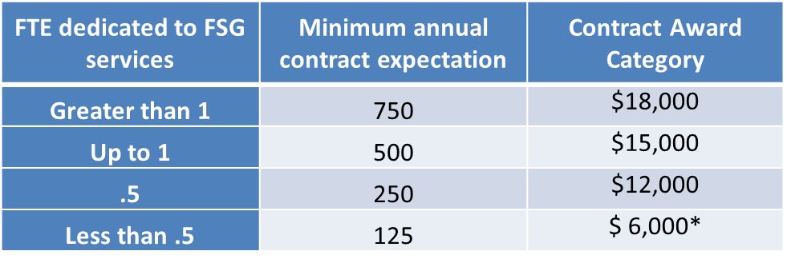
Contract Award Amounts
Contract awards are conditional upon the projected number of families to be served annually.
May only apply for direct service costs including personnel, FSG educational materials, and required FSG trainings.
*Reserved for special circumstances; consultation is required and this category must be pre-approved prior to submitting application

Slide 12
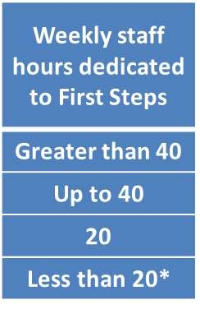
Contract Award
Funding is conditional upon the projected number of families served annually and amount of FTE dedicated to the work.
* Reserved for special circumstances; consultation is required and this category must be pre-approved prior to submitting application.

Slide 13
Contract Award
FTE – Full Time Equivalent
Ex. If you have a part time person (.5 FTE), you would be expected to serve a minimum of 250 families and the contract award would be $12k.
The minimum requirements for each funding level are set in the chart on the previous slide. This is also a competitive grant. As you create your community plan, you will need to look at who your community partners are and what the capacity is through those access points for serving families.
Contracted goals should be realistic and achievable, but extra consideration will be given to applicants who propose serving as many families as possible.
Again, for current First Steps Mini-Grant sites, you should apply to serve at minimum, the same number of families that you are currently serving through this year’s contract with your FTE remaining the same as your current FSG Mini-Grant contract.

Slide 14
Contract Timeline
SoN due with a postmarked date of May 9, 2016.
Those awarded will have a start date of October 1, 2016.
For those existing First Steps sites, full services must begin October 1, 2016.
For those new First Steps sites, October and November can be used as a hiring/training period and full service implementation will be expected by no later than December.
The contract period will end September 30, 2017.

Slide 15
Contract Development Timeline

Slide 16
Contract Development Timeline
Contract Award Period
Will cover a 12-month period, from October 1, 2016 – September 30, 2017.
FSG sites must continue service delivery activities for the full contract period.

Slide 17
Application Submission Instructions
Actions required prior to submission:
Prior to the creation of your application, all applicants must confer with the GSG Community Outreach Coordinator, Lynda Brown.
Must submit draft FSG community plan to Lynda Brown for review by no later than April 29, 2016.
For new applicants: Proposals must be submitted to Lynda Brown for review by April 29th prior to submission to DFCS-OPFS.. All service delivery activities (new, enhanced or expanded services) must begin within 90 days of the start date of the contract award.

Slide 18
Application Instructions
Submit one (1) original application, four (4) copies of original, and one (1) electronic copy on CD or thumb drive.
Original copy should have signatures in blue ink.
Bind the original application with binder clips.
The application must be submitted in order of the chart listed on page 9 of the SoN (3f. Application Order).
Submit application with a postmarked date no later than 5:00 pm on May 9, 2016.
We will not accept hand deliveries, office-metered postmarks, faxed or emailed applications.

Slide 19
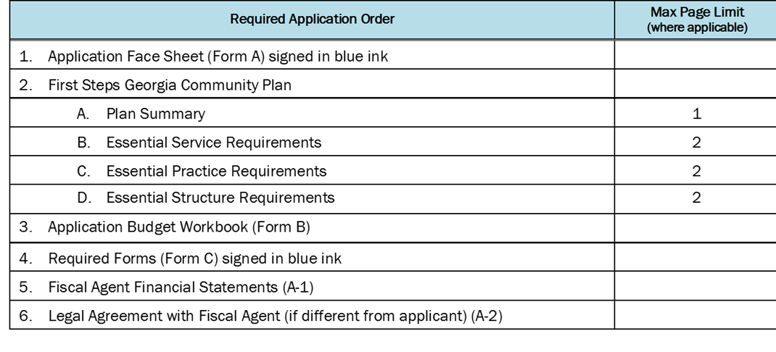
Application Order
Submit all required documentation to the following address:
Georgia Division of Family and Children Services
ATTN: First Steps Georgia
2 Peachtree Street, NW, 26th Floor
Suite 26-266
Atlanta, Georgia 30303

Slide 20
Application Formatting
Number every page.
12 point font, 1 inch margins.
White paper, 8 ½ inches by 11 inches.
Footer with the fiscal agent’s name and page number.
Adhere to page limits for the FSG community plan.
Only use paperclips and binder clips to bind.
Restate and number each FSG community plan narrative question, followed by the plan specifics for your site.

Slide 21
First Steps Georgia Community Plan
Plan Summary [1 page]
Essential Service (Function) Requirements [2 pages]
Essential Practice Requirements [2 pages]
Essential Structure Requirements [2 pages]
A detailed statement of the work to be undertaken and answers the who, what, when, where, and how statements of the application.

Slide 22
FSG Community Plan Breakdown
Plan Summary
Fiscal Agent: state name of applicant.
Target Population to be served: total number of families projected to be served.
Description of FSG services: a detailed statement of how your First Steps services will work and what it will look like for your community.
- Include geographic location to be served.
- Example: “We plan to target First Steps services in X county to serve all mothers of newborns which are delivered at X hospital. This service will look like…”

Slide 23
FSG Community Plan Breakdown Essential Service (Function) Requirements
Identification and Referral:
Community Outreach:
Community Collaboration:
Screening:
Method for screening families.
Identify locations where screens will be completed.
Other potential locations for entry into FSG services.
Describe plan for communication between First Steps and home visiting, where applicable.
Parent Education:
Describe how materials will be provided to families.
Process for internal review of materials.
Linkage:
Plan for linking families to relevant resources.
List other services available within your organization to which families may be referred.

Slide 24
FSG Community Plan Breakdown Essential Service (Function) Requirements
Describe process for program entry into First Steps in your community by providing a detailed response to each of the following: Identification and Referral, Screening, Parent Education and Linkage (see previous slide)
*Note: having identified places to connect with families from the beginning is important. This is so you aren’t searching for places after the contract year starts. These places should be clearly laid out in your proposal.
Where to find “pre-approved list of materials” = Lynda Brown
Relevant and age-appropriate materials and information.
Describe the localized, annually updated Community Resource Guide.
The screening process for First Steps Georgia must include the use of the Great Start Georgia Core Screening Tool.

Slide 25
FSG Community Plan Breakdown
Describe training plan for service providers.
Describe how you plan to administer the GSG Central Intake Core Screen at your site.
Describe your plan for surveying families who have been provided FSG services, using the FSG Family Satisfaction Survey.
Describe how parent packet educational materials will be selected.
Describe anticipated contact with GSG Community Outreach Coordinator and other appropriate GSG technical assistant(s) for FSG technical assistance during the contract year.

Slide 26
FSG Community Plan Breakdown
Who will be responsible for implementation of FSG community plan?
Describe the hiring process for direct service staff.
FSG Staffing:
Specify the location of work space for FSG staff.
Will volunteers and/or interns be used for FSG direct services? If yes:
- Describe screening process for hiring.
- Describe process for training.
- Who will supervise and with what frequency?
FSG Data Entry:
Describe how FSG data will be maintained onsite.
Who will be responsible for ensuring efficient and accurate data entry into the GSG data management system(s)?

Slide 27
Application Budget
Applicants may only apply for direct service costs including:
Personnel working directly with families/communities;
Can include salary and/or hourly employees.
Base amounts on FTE applied to work.
2) FSG educational materials; and/or
Can only include materials to be used in the parent packets given directly to families.
Can purchase materials from outside sources or print handouts ‘in house’ to be given out.
3) Required FSG trainings.
Core FSG trainings (initial): Screening tool, data system
Regional FSG trainings (periodic): webinars and face-to-face
Home Visiting Institute (annual)

Slide 28
Application Budget – Required FSG Trainings
There is a one-day training required at the onset. The training is offered regionally during the start-up phase (see timeline slide) and is provided at no charge to sites. There could be travel required, if it is more than a few hours from your location. Beyond the initial training; monthly webinars, regional networking meetings, Technical Assistance contact (phone or onsite) and semi-annual state-wide meetings are offered through OPFS and/or Lynda Brown.
The screening tool and guide are covered during training. (Copies of each can be provided by Lynda if requested). FSG interaction with families is done in a conversational style, not as a checklist. Please don’t let the length of the tool discourage you – most sites create a “cheat sheet” that is much shorter, but reminds them of key points to cover during their discussion.

Slide 29
Application Budget Workbook
Complete Budget Workbook (Form B) in Excel format.
Budget summary must provide computation of requested funds and justification of costs.
Detailed budget narrative should also be included.
Must provide details on each cost item for clarity of expenses requested in the different budget categories.

Slide 30
Budget Template Instructions
Type in the name of the applicant on the first line of each worksheet.
Use the tabs at the bottom of the workbook to select the Proposed Budget Summary or Budget Narrative.
*Note: workbook is locked in some places. Contact OPFS if you require assistance.
Proposed Budget Summary
Amounts entered into the worksheet columns for personnel will auto-calculate numbers and filter into the “Contract Request” column.
All “Contract Request” fields in the workbook will auto-sum into each budget category total and the “Total Budget.”
Budget Narrative
All costs will need to be accompanied by a written description within the narrative, which clearly details and justifies proposed costs.

Slide 31
Application Forms and Attachments
Form A: Application Face Sheet – Ensure signature of Executive Officer of applicant agency (and fiscal agency, if different), signed in blue ink
Form B: Application Budget Workbook – Must be submitted in Excel. Must submit 1) budget summary and 2) budget narrative and justification
Form C: Required Forms – Ensure signature of Executive Officer of fiscal agent, signed in blue ink; dates must match the contract period
Background Check Documentation
Tax Compliance Form (non-profits only)
Security Immigration and Compliance Contract Affidavit (non-profits only)
Certificate of Liability Insurance – Para 129 Form (non-profits only)
Corporate Resolution (non-profits only)
Vendor Management Form
W-9 Form
Attachment 1: Fiscal Agent’s Financial Statements (if a first time applicant)
Attachment 2: Legal Agreement with Fiscal Agent (if different from applicant)

Slide 32
Selection and Contract Award Agreement
Selection of Applicants
All eligible applications will go to a review committee who will review, score and rank the applications.
Applications are selected on a competitive basis.
OPFS will send out award notifications via U.S. mail and/or email.
Contract Award Agreement
OPFS will offer a performance-based contract agreement.
Payments will be based on achievement of specific accomplishments of process and quantitative outcomes rather than incurred cost of the contractor.
OPFS reserves the right to make changes to the application budget at the time of the contract award and will communicate any changes to the fiscal agent.
OPFS may negotiate all or part of your proposed budget.
If awarded a contract, it is mandatory to participate in OPFS contract award management and reporting training as requested.

Slide 33
Data Reporting
Data Management System
By the end of each quarter, the contractor will ensure that service and participant data are reported through the prescribed data management system.
Data Management System:
Great Start Georgia Home Visiting Information System (GEOHVIS)

Slide 34
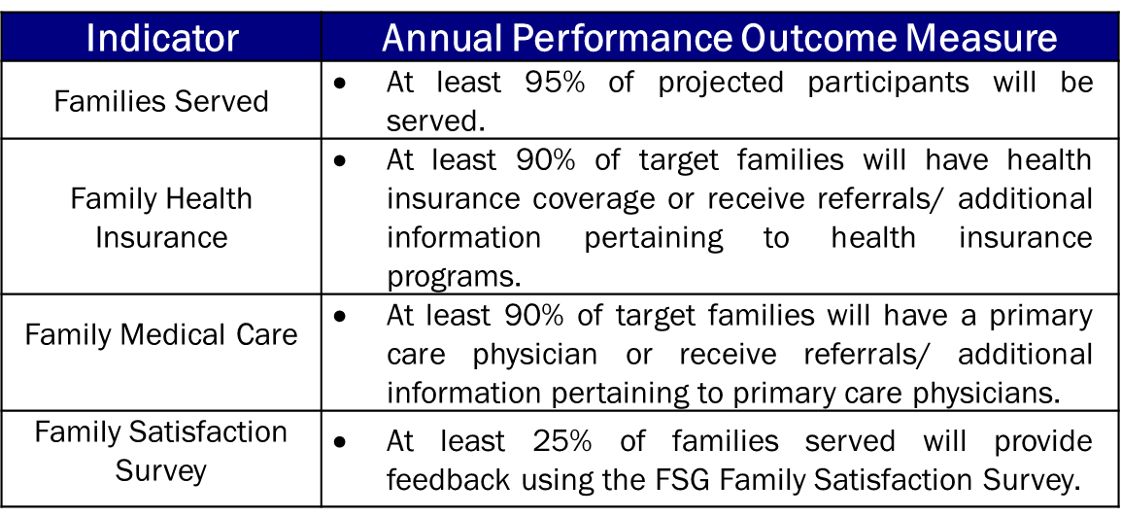
Performance Outcome Measures

Slide 35
Performance Outcome Measures
The performance report and payment request will be submitted on a semi-annual basis, every six (6) months.
All applicants applying for funding for First Steps Georgia in their community will be required to meet the OPFS performance outcome measures (for the year) described on the previous slide.

Slide 36
Performance Outcome Measures
Expected Performance Measures for the contract year:
- Will be looking at number of families to align with application narrative.
- There is also a 6 month performance outcome measure with families served = 50%
First Steps Georgia Parent Satisfaction Survey
- Survey of families to measure family satisfaction with supports, services, and materials will be required of contractors.
Aggregated quarterly reporting of survey data in GEOHVIS must be submitted to OPFS during the both reporting periods. This report will come from Lynda.
Additional reporting requirements:
- You will submit a signed Performance Report and Payment Request form each period (this is included in your contract as an Annex), you will enter service and participant data into GEOHVIS, as well as have any contract- funded materials approved for branding during each period (prior to use with families).

Slide 37
Contact Information
OPFS Finance Contact: Troy Scott
Troy.Scott@dhs.ga.gov
404-657-5140
OPFS Program Contact:
Laura Griggs
Laura.Griggs@dhs.ga.gov
404-657-5152
First Steps Georgia Contact:
Lynda Brown
lfbrown@uga.edu
(478) 719-8000
http://dfcs.dhs.georgia.gov/future-funding-opportunities
Thank you!

