Slide 1




State of Hope
Virginia Pryor
June 2018
Division Director
Notes:
Welcome & Introductions

Slide 2
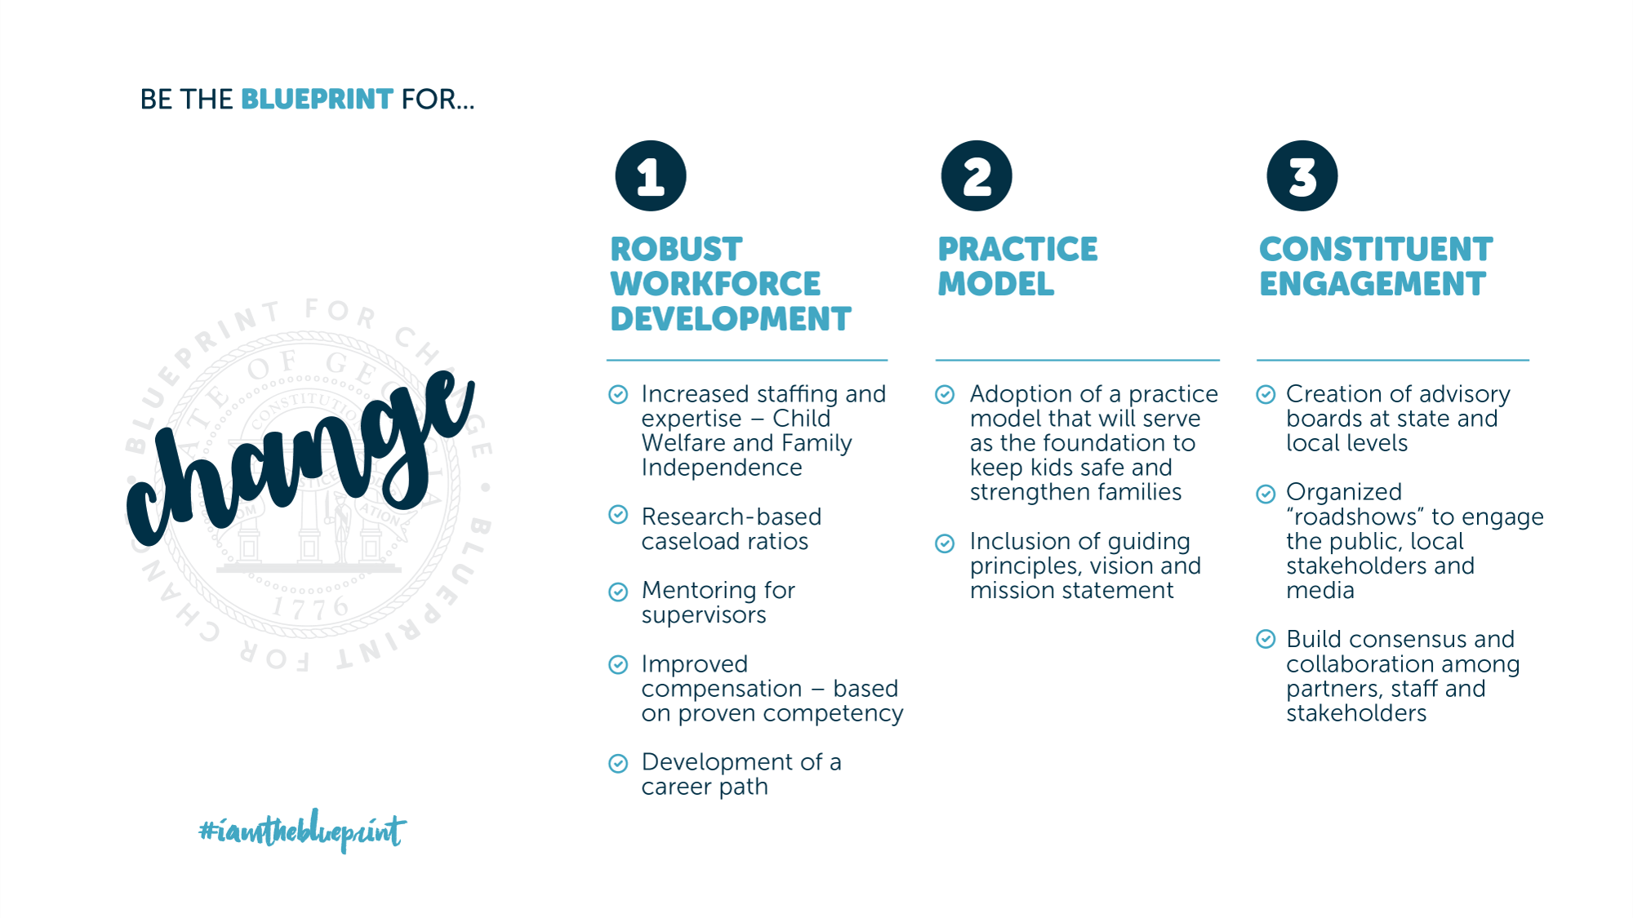
State of Hope
Notes:
The Blueprint for Change was the Division of Family and Children Services’ internal reform effort as a result of Senate Bill 138. While the Division will continue to focus on our internal three pillars, we are now on a journey toward a State of Hope, where communities will use their collective impact to wrap services around their most vulnerable members.

Slide 3

State of Hope
Notes:
As you see – the Blueprint for Change PLUS the State of Hope will equal – Safe Children, Strengthened Families and a Stronger Georgia. That is the Division’s vision.

Slide 4
State of Hope
Why Hope for Georgia?
Hope is needed in every Georgia community because families deserve to be safe, supported and have resources that are designed with their input. Additionally, there is a record number of children in foster care, resources are limited and many individuals and families are in crisis. Our local communities often have the best answers to address these local needs.
“For evil to succeed, all it needs is for good men to do nothing.” Rev. Dr. Martin Luther King, Jr.
Notes:
Food insecurity, lack of medical care and poverty are all tremendous stressors that could lead to the Division of Family and Children Services’ involvement with families. All of us working together can be Hope-Givers in our communities

Slide 5

State of Hope
Why Hope for Georgia?
Notes:
In 2015, there were approx. 2.5m children under 18 in GA total - 20% have food uncertainty/ 89% of foster youth do NOT graduate from HS/#of youth in Foster care rose to over 15,000.

Slide 6
State of Hope
WHAT IS STATE OF HOPE?
The State of Hope is a movement throughout Georgia to create communities where children are safe, thriving, and full of hope. Our mission is to cultivate family-centered support systems by connecting, equipping, and nurturing diverse community collaborators.
Notes:
So what exactly is a State of Hope? The State of Hope is a movement throughout Georgia to create communities where children are safe, thriving, and full of hope. Our mission is to cultivate family-centered support systems by connecting, equipping, and nurturing diverse community collaborators. This is the vision and mission of State of Hope.
.

Slide 7
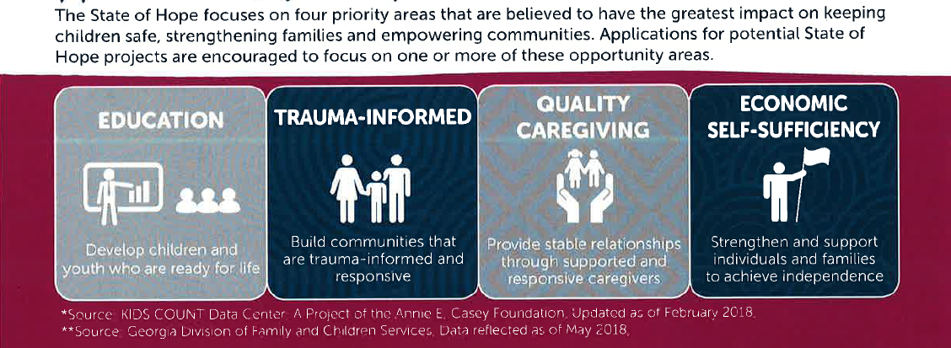
State of Hope
What is State of Hope?
Notes:
We believe that focusing on these four priority areas will have the greatest impact and make a difference in the lives of families.

Slide 8
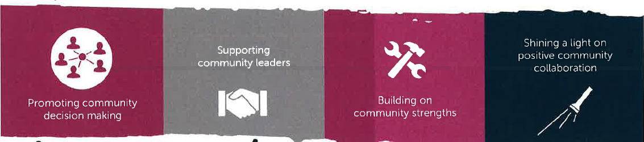
State of Hope
What is State of Hope?
Notes:
We believe our own communities to be the most powerful source to help make progress.

Slide 9
State of Hope
WHAT IS STATE OF HOPE?
The State of Hope seeks to activate communities, including nonprofits, philanthropies, government, businesses and other community members to collaborate closely to build local safety nets that will prevent conditions that contribute to disparities in education, threaten a family’s self-sufficiency and could lead to child abuse and neglect.
Our ultimate vision is to have one or more State of Hope sites in each of the 14 regions across Georgia.
Notes:
While there is a small amount of seed funding, we want State of Hope not to be another grant-focused program , but to be considered a movement. We want State of Hope sites across the state of Georgia & we want them to be able to learn and grow in community with each other.

Slide 10
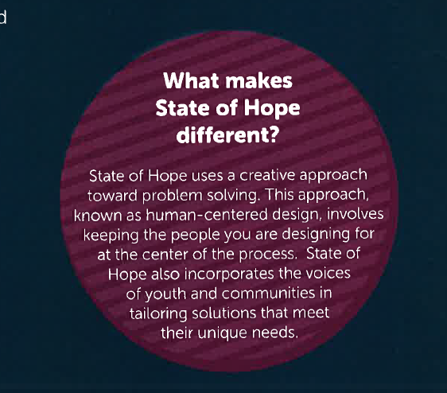
State of Hope
Notes:
State of Hope is different in that it utilizes a human-centered design approach to solve problems. This approach involves engaging the people you are designing for in the process. Seeking their input for solutions that will meet their needs.

Slide 11
Radical Community Mindset Shift
More Comprehensive and Accessible Array of Resources
Enhanced Community Collaboration
Improved Community Data Points
State of Hope
How will communities be different because of State of Hope?
Notes:
Our big bet is that if we bring State of Hope to every community across GA, we will see these 4 major outcomes
This is not where we are today. This is a different state, and we believe SOH can help us get there.
Do we see this happening already? How will we know that this is happening?

Slide 12
State of Hope
STATE OF HOPE: 2019 TIMELINE
2019 | Activity
January | State of Hope Tool Kit (“Hope Kit”) distribution will launch the application process
February -March | Innovators will submit their stories (application) via online application
April | Community Review Leads will assemble teams to select and prioritize local ideas/projects
April- May | State level team will make final selections
May | Selection announcements to be communicated to all applicants
Spring 2019 | Meet with top sites to move projects forward
July 1st | Possible 3rd Round of Applications

Slide 13

State of Hope
State of Hope Application Overview
Virginia Pryor
June 2018
https://dfcs.georgia.gov/state-hope
Notes:
The State Hope application is online. You can access it through the SoH Toolkit on our site.

Slide 14
State of Hope
Table of Contents
Notes:
The SoH Toolkit provides a wealth of information and resources that can be used whether or not you apply to become a State of Hope site. It is interactive, just click on the item you want to view. The toolkit also houses the SoH application.

Slide 15
State of Hope
Business Case
Notes:
The Business Case is a tool designed to help promote State of Hope and inform business and community partners of the need for HOPE in Georgia. It is accessible through the Toolkit and may be downloaded and printed.

Slide 16
State of Hope
Frequently Asked
Questions
Notes:
The SoH Toolkit also has a FAQs section that can answer question you may have regarding State of Hope.

Slide 17
State of Hope
HOW CAN YOU BE INVOLVED?
Learn more about the State of Hope. Review the information on the website: https://dfcs.georgia.gov/state-hope.
Connect with at least one partner and/or community member (community leader, church member, friend, Family Connection collaborative) to talk about State of Hope, the application, and discuss possible opportunities.
Share the Hope Tool Kit widely located on the website above.
Volunteer to serve on a Regional Community Review Team - StateofHope@dhs.ga.gov
Email StateofHope@dhs.ga.gov if you have any questions or ideas that you want to share with us.
Notes:
Here are ways that you can be involved.
THE ASK
Continue to educate yourself about State of Hope
Be a resource for community members and organizations
Share widely with your network, stakeholders, etc.
Serve on a Community Review Team

Slide 18

State of Hope
Questions & Answers
“Once you choose hope,
anything's possible.”
Christopher Reeve
Notes:
Each and every one of us can be Hope Champion - spreading the message of Hope and being Hope-Givers in our respective communities. We invite everyone who cares about their community, believes they can make a difference, and wants families and children to thrive to apply to join this movement.

Slide 19

State of Hope
WEBSITE: www.dfcs.georgia.gov/state-hope
QUESTIONS: StateofHope@dhs.ga.gov
Notes:
Closing notes

