Slide 1




Virginia Pryor
June 2018
Division Director

Slide 2
State of Hope
Why do we need HOPE?
Hope is needed in every Georgia community because families deserve to be safe, supported and have resources that are designed with their input. Additionally, there are a record number of children in foster care, resources are limited, and many individuals and families are in crisis. Our local communities often have the best answers to address these local needs.
“For evil to succeed, all it needs is for good men to do nothing.” Rev. Dr. Martin Luther King, Jr.
Notes:
Food insecurity, lack of medical care and poverty are all tremendous stressors that could lead to the Division of Family and Children Services’ involvement with families. All of us working together can be Hope-Givers in our communities.

Slide 3
State of Hope
WHAT IS STATE OF HOPE?
The State of Hope is a movement throughout Georgia to create communities where children are safe, thriving and full of hope.
The State of Hope seeks to activate nonprofits, philanthropies, government, businesses and communities to collaborate closely to build local safety nets that will prevent conditions that contribute to disparities in education, threaten a family’s self-sufficiency and could lead to child abuse and neglect.
Our ultimate vision is having 14 Regions of Hope across Georgia. This could be one or multiple sites/projects in each region.
Notes:
So what exactly is a State of Hope? The State of Hope initiative seeks to activate nonprofits, philanthropies, government, businesses and communities to collaborate closely to build local safety nets that will prevent conditions that contribute to disparities in education, threaten a family’s self-sufficiency and could lead to child abuse and neglect. Our ultimate vision is having 14 Regions of Hope across Georgia. This could be one or multiple sites / projects in each region.
It is a collaborative approach in which people from all walks of life share a vision of safety and success for every child, family and individual who lives in their community.

Slide 4

State of Hope
STATE OF HOPE MISSION
Our mission is to cultivate family-centered support systems by connecting, equipping and nurturing diverse community collaborators.
Notes:
The value proposition, created by the Design Team last year, lays our stake in the ground around what State of Hope ultimately seeks to accomplish.

Slide 5
State of Hope
STATE OF HOPE CORE PARTNERS
Notes:
While the Division is taking the lead on this initiative, we have partnered with the Georgia Family Connection Partnership, and the Georgia State University School of Social work, specifically the Child Welfare Training Collaborative, as core partners. Together, we are working to bring Hope across Georgia.

Slide 6
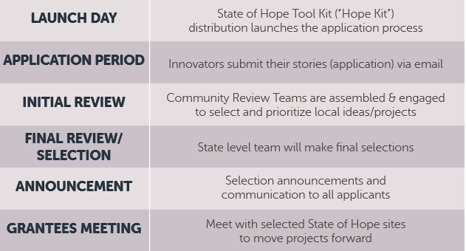
State of Hope
STATE OF HOPE HIGH-LEVEL APPLICATION SELECTION PROCESS
Notes:
Here is a high-level timeline for roll-out of the State of Hope.

Slide 7

State of Hope
STATE OF HOPE
APPLICATION
The State of Hope Application will incorporate story-telling:
Your Community of Hope Story
Notes:
Our application will be simple, so that any community member that has a good idea, a spark of hope, may apply. We will ask the applicant, the Hope Innovator, to tell us about themselves, their big idea, what resources are needed and what success will look like.

Slide 8
State of Hope
OPPORTUNITIES FOR HOPE
These are the priority areas that we believe will have the greatest impact on keeping children safe, strengthening families, and empowering communities.
Notes:
The Division has four Opportunities for Hope for this initiative. These are the priority areas that we believe will have the greatest impact on keeping children safe, strengthening families and empowering communities. The hope is that applications for potential State of Hope projects are focused on one or more of these opportunity areas.

Slide 9

State of Hope
OPPORTUNITIES FOR HOPE
Education: Improving the educational attainment of vulnerable youth, most importantly the graduation rates of youth in foster care
Trauma-Awareness: Increasing the awareness of trauma informed practices, the impact of trauma and how to mitigate its impact
Quality Caregiving: Improving the quality of caregiving across a continuum including, but not limited to, birth parents, kin caregivers, foster/adoptive parents and the larger caregiver community
Economic Self-Sufficiency: Strengthening and supporting individuals and families on their path toward independence
Notes:
The Division has four Opportunities for Hope for this initiative. These are the priority areas that we believe will have the greatest impact on keeping children safe, strengthening families and empowering communities. The hope is that applications for potential State of Hope projects are focused on one or more of these opportunity areas.

Slide 10
Within the four Opportunities of Hope, emphasis are placed on supporting Big Ideas that promote Georgia’s Six Objectives for Prevention.
State of Hope
FUNDING PRIORITIES
Over the next decade, six objectives have been identified in Georgia’s Child Abuse and Neglect Prevention Plan as community conditions that must change in order for collective action to work and achieve Georgia’s vision for prevention.
Georgia’s Prevention Plan was developed from the consideration of feedback received from service providers and professionals, parents, caregivers, local leaders (government, civic/community, faith, and business), and community members across the state’s 14 DFCS regions.
You can learn more about this plan by reviewing Georgia’s Child Abuse and Neglect Prevention Plan (GCANPP) located in the Hope Connections Section.
OBJECTIVES FOR PREVENTION
Increase family economic stability
Increase family resiliency
Increase access to early childhood education
Increase family mental health
Increase family physical health
Increase community knowledge and awareness of the societal factors that contribute to child abuse and neglect and the capacity to prevent it.
Notes:
The Division has four Opportunities for Hope for this initiative. These are the priority areas that we believe will have the greatest impact on keeping children safe, strengthening families and empowering communities. The hope is that applications for potential State of Hope projects are focused on one or more of these opportunity areas.

Slide 11
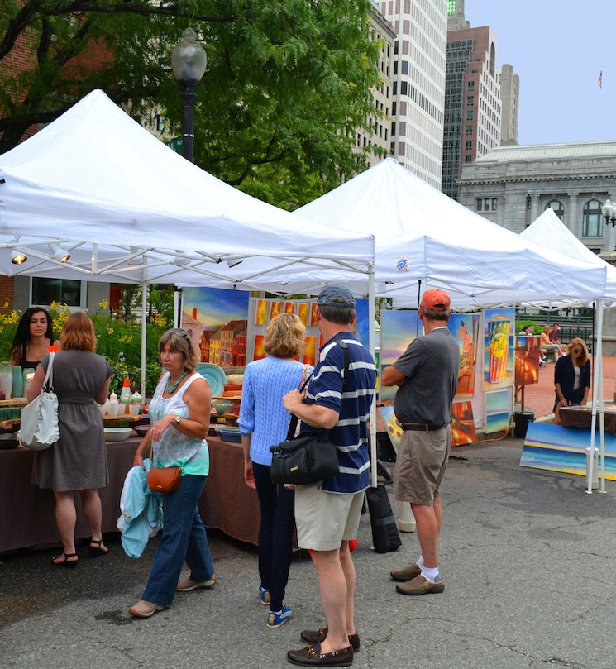
State of Hope
STATE OF HOPE
Community Engagement for Applicants
The State of Hope Application will ask applicants to gather input on their ideas and information on community needs via local community gatherings to ensure ideas are created with a human-centered approach:
Festivals
Civic Dinners
Church Events
Town Hall Meetings
Surveys and Focus Groups
Family Connection Collaborative Meeting
And the list goes on….
#Gotowherethepeopleare
Notes:
Since one of our key tenants of State of Hope is to design something the community wants (with them, not for them without their input), we are asking applicants to attend a community gathering, get feedback on their big idea and let us know what they learned.

Slide 12
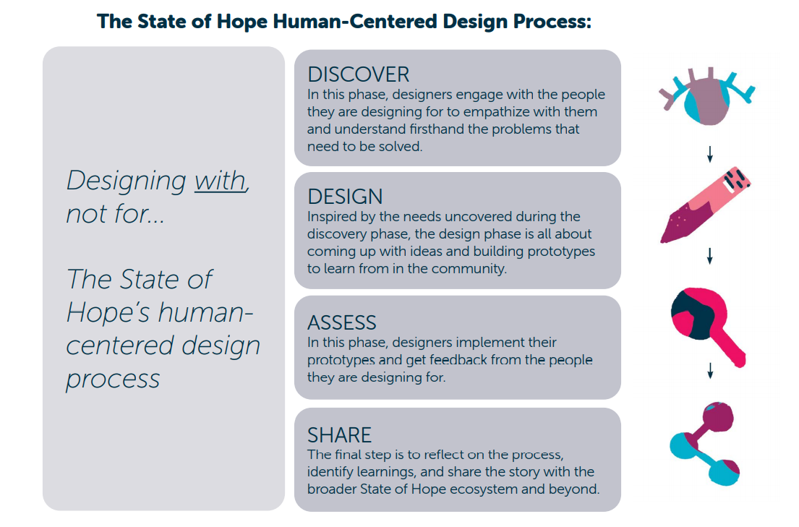
State of Hope
THE STATE OF HOPE
HUMAN-CENTERED DESIGN PROCESS
Human-centered design is a creative approach to problem solving that involves keeping the people you are designing for at the center of the process and tailoring solutions that meet their unique needs.
Notes:
WHY THIS APPROACH?
Georgia has long struggled to create support systems that are sufficient to address the needs of all children and families in crisis.
Human-centered design is a proven process for developing innovative solutions by collaboratively coming up with ideas that are desirable to families and children, viable to build, and feasible to execute.

Slide 13

State of Hope
STATE OF HOPE COMMUNITY REVIEW TEAMS
Regional Community Lead Reviewers will be selected. These leaders will be responsible for assembling local Community Review Teams that will review and make selections, prioritize local projects, and send the results back to the State Review Team.
Notes:
In the selection process, it is important to have local community input into the projects that are selected as State of Hope sites. We will be reaching out to Regional-level leaders – DFCS staff, Family Connections Regional Coordinators, State of Hope Advisory Council, DFCS Advisory Board members, etc. – to convene local teams to review applications from their regions and make the State of Hope recommendations for selection. Community Review Team Members will be made up of representation within their region to include youth representatives, parents, and the community-at-large (Law Enforcement, Education, Emergency Responders, Mental Health, Pediatric Health Care, CASA, Juvenile Justice, Private Child Welfare and/or Faith-Based Community Leaders).

Slide 14
State of Hope
STATE OF HOPE STATE REVIEW TEAM
The State Review team will make final decisions on which State of Hope sites will be supported with formal funding. All other applicants will be invited to join and connect to the “Hope Ecosystem” and receive access to resources.
Notes:
The prioritized list will be sent from the community teams to a state review team for the final selections.

Slide 15
State of Hope
STATE OF HOPE ECOSYSTEM SITE CATEGORIES
All applicants will be categorized into one of two types of sites:
State of Hope Funded Site Formal funding and technical assistance provided. Supported with resources in the Hope Ecosystem. |  | State of Hope Site Non-Funded No formal funding but supported with technical assistance and resources in the Hope Ecosystem.
Notes:
We want this process to be engaging and simple. We also want to ensure that we are activating a network of community nonprofits, businesses, and community members to cultivate family-centered support systems for our children and families across the State of Georgia. Therefore, applications will be placed into two categories by community review teams:
1) FUNDED SITES: Applicants receive funding and technical assistance.
2) NON-FUNDED SITES: The applications they feel represent great work, and should be branded as State of Hope sites, but may not receive funding. These sites will be invited to connect to the Hope Ecosystem and will have the opportunity to receive formal technical assistance and other resources in the Hope Ecosystem.

Slide 16
State of Hope
STATE OF HOPE SELECTION NOTIFICATION
All applicants who are invited to join the State of Hope become part of the Hope Ecosystem, where we connect, learn and collaborate to create family-centered support systems.
Thank you for applying!
Notes:
And then the selections will be made and all applicants notified.

Slide 17
State of Hope
STATE OF HOPE ECOSYSTEM
State of Hope Members have access to specialized professional development, technical assistance, and a community of talented collaborators.
Connect- Meet other State of Hope members and practice human-centered design.
Learn- Interactive training experiences on creative fundraising, trauma- informed practices, data and evaluation and more.
Collaborate- Form cross-sector teams to discover unmet needs in local communities, brainstorm ideas to strengthen families and share stories of success and lessons learned.
Notes:
The top 3-5 selected sites will receive funding and technical assistance, but all State of Hope sites will be connected to a larger “Hope Ecosystem” to enhance collaboration, learning and access to additional resources (grant opportunities, access to partners, etc.).

Slide 18
State of Hope
STATE OF HOPE ECOSYSTEM
What will the SOH Ecosystem offer Members?
  Trauma training for the community
  Capacity-building around the design thinking process for project implementation
  Additional specialized technical assistance as needed
  Seed funding – small seeds of HOPE to sites selected for funding
Notes:
The top 3-5 selected sites will receive funding and technical assistance, but all State of Hope sites will be connected to a larger “Hope Ecosystem” to enhance collaboration, learning and access to additional resources (grant opportunities, access to partners, etc.).

Slide 19
State of Hope
HOW CAN YOU BE INVOLVED?
Learn more about the State of Hope. Review the information on the website: https://dfcs.georgia.gov/state-hope.
Connect with at least one partner and/or community member (community leader, church member, friend, Family Connection collaborative) to talk about State of Hope, the application, and discuss possible opportunities.
Share the Hope Tool Kit widely located on the website above.
Email StateofHope@dhs.ga.gov if you have any questions or ideas that you want to share with us.
Notes:
Here are ways that you can be involved.

Slide 20

State of Hope
“Once you choose hope,
anything's possible.”
Christopher Reeve
Notes:
Each and every one of us can be Hope Champion - spreading the message of Hope and being Hope-Givers in our respective communities. We are so excited to have you join us as we journey toward a State of Hope in Georgia!

Slide 21

Thank You!
StateofHope@dhs.ga.gov
https://dfcs.georgia.gov/state-hope
Notes:
More information can be found on our website at https://dfcs.georgia.gov/state-hope. Additionally for questions or suggestions, please email StateofHope@dhs.ga.gov.

